Slide 1

CoVID-19 WEEKLY Bulletin
10th September – 16th September 2020
No figures should be considered as Official Police Statistics. These may not yet have been verified or validated.

Slide 2
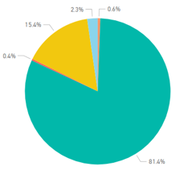
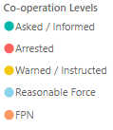
Service Centre Demand
Crime Levels
Coronavirus Legislation
Service Centre Demand
Crime Volume (9 March – Present compared to Previous Year)
Co-operation with new Coronavirus Legislation
The volume of 101 calls answered have remained relatively static over the course of this week. The volume of 999 calls showed an increase over the weekend and thereafter reduced at the end of the week.
Crime has continued to trend at levels lower than the seasonal average, and total volume year to date is still considerably lower than last year. Total ‘Year to Date’ volume is displayed below, further data is available in the Crime slide.
The below chart is indicative of the co-operation levels experienced by police over the last 7 days. The vast majority of interactions between police and the public continue to be resolved without enforcement.
Incident Demand
Incident Demand
Incident volume shows a slight increase over the weekend 11th and 12th September, thereafter returning and remaining at consistent levels for the remainder of the week. Overall incident volume continues to show lower levels compared to the same time last year.
Total Number of Enforcement Activity Relating to Coronavirus Legislation
Staff Absence and Welfare
Staff Absence and Welfare
Absences
Absences had generally trended lower when compared to 2019. However there has been a recent increase in absences that have now seen a return to 2019 levels.
Staff COVID Screening
Testing of key workers for COVID-19 continues and the number of tests arranged for Police Scotland employees is broken down later in this report.
Enforcement Activity over last 7 days | 16
Total Referrals to 13th September
Public Health Scotland Travel Regs. Referrals | 176
Investigated by Resolution Team | 76
Investigated by Local Policing | 90
Investigations Ongoing | 10
FPNs issued for breach of Travel Regs. | 2
House Gatherings in Private Dwellings
From 10th - 16th September police attended 560 ‘House Party’ Incidents.
Further data is available in the Incident Demand – House Gatherings slide.
Note: The referral figures are a count of reports submitted to Police Scotland. These will therefore vary from counts of the number of individuals.
FPN may be derived from both PHS and Home Office Referrals.
No figures should be considered as Official Police Statistics. These may not yet have been verified or validated.

Slide 3

Weekly Service Centre Demand (10th – 16th September 2020)
 | 10-Sep | 11-Sep | 12-Sep | 13-Sep | 14-Sep | 15-Sep | 16-Sep | Total
2020 101 Ans | 3555 | 3419 | 3456 | 3335 | 3528 | 3506 | 3690 | 24489
2020 999 Ans | 1555 | 1923 | 1946 | 1937 | 1820 | 1919 | 1746 | 12846
2019 101 Ans | 4502 | 4700 | 4521 | 4404 | 4292 | 3984 | 5009 | 31412
2019 999 Ans | 1587 | 1613 | 1614 | 2010 | 2130 | 1932 | 1556 | 12442
No figures should be considered as Official Police Statistics. These may not yet have been verified or validated.

Slide 4
Cumulative Service Centre Demand (19th March – 16th September 2020)
Total | Total |  |  |  |  |  |  |  |  |  |  |  |  |  |  |  | March |  | 19-Mar | 20-Mar | 21-Mar | 22-Mar | 23-Mar | 24-Mar | 25-Mar | 26-Mar | 27-Mar | 28-Mar | 29-Mar | 30-Mar | 31-Mar
2020 101 Ans | 760149 |  |  |  |  |  |  |  |  |  |  |  |  |  |  |  | 2020 101 Ans |  | 3029 | 3362 | 3484 | 2852 | 4196 | 4755 | 4499 | 4510 | 4784 | 4169 | 3115 | 4977 | 4866
2020 999 Ans | 308888 |  |  |  |  |  |  |  |  |  |  |  |  |  |  |  | 2020 999 Ans |  | 1904 | 2038 | 1929 | 1558 | 1311 | 1447 | 1336 | 1299 | 1471 | 1391 | 1302 | 1314 | 1259
April | 01-Apr | 02-Apr | 03-Apr | 04-Apr | 05-Apr | 06-Apr | 07-Apr | 08-Apr | 09-Apr | 10-Apr | 11-Apr | 12-Apr | 13-Apr | 14-Apr | 15-Apr | 16-Apr | 17-Apr | 18-Apr | 19-Apr | 20-Apr | 21-Apr | 22-Apr | 23-Apr | 24-Apr | 25-Apr | 26-Apr | 27-Apr | 28-Apr | 29-Apr | 30-Apr
2020 101 Ans | 4579 | 4550 | 4506 | 3753 | 3618 | 4935 | 4873 | 4663 | 4332 | 4954 | 4654 | 4394 | 4881 | 4846 | 4780 | 4861 | 4793 | 4874 | 4303 | 4856 | 4647 | 4728 | 4530 | 4910 | 5101 | 4311 | 4739 | 4647 | 4295 | 4494
2020 999 Ans | 1204 | 1145 | 1333 | 1440 | 1355 | 1272 | 1432 | 1312 | 1426 | 1545 | 1739 | 1386 | 1182 | 1232 | 1403 | 1238 | 1391 | 1406 | 1354 | 1248 | 1348 | 1408 | 1353 | 1752 | 1808 | 1231 | 1137 | 1090 | 1106 | 1082
May | 01-May | 02-May | 03-May | 04-May | 05-May | 06-May | 07-May | 08-May | 09-May | 10-May | 11-May | 12-May | 13-May | 14-May | 15-May | 16-May | 17-May | 18-May | 19-May | 20-May | 21-May | 22-May | 23-May | 24-May | 25-May | 26-May | 27-May | 28-May | 29-May | 30-May | 31-May
2020 101 Ans | 4884 | 5017 | 4069 | 4630 | 4340 | 4751 | 4665 | 5008 | 4865 | 3974 | 4764 | 4701 | 5205 | 4668 | 5080 | 4412 | 3898 | 4754 | 4576 | 4302 | 4235 | 4652 | 4131 | 3911 | 4600 | 4629 | 4563 | 4264 | 4260 | 3935 | 3626
2020 999 Ans | 1369 | 1509 | 1353 | 1257 | 1461 | 1761 | 1644 | 1670 | 1666 | 1240 | 1257 | 1135 | 1244 | 1344 | 1322 | 1510 | 1271 | 1295 | 1407 | 2185 | 1831 | 1500 | 1278 | 1325 | 1467 | 1613 | 1702 | 1961 | 2741 | 2936 | 2342
June | 01-Jun | 02-Jun | 03-Jun | 04-Jun | 05-Jun | 06-Jun | 07-Jun | 08-Jun | 09-Jun | 10-Jun | 11-Jun | 12-Jun | 13-Jun | 14-Jun | 15-Jun | 16-Jun | 17-Jun | 18-Jun | 19-Jun | 20-Jun | 21-Jun | 22-Jun | 23-Jun | 24-Jun | 25-Jun | 26-Jun | 27-Jun | 28-Jun | 29-Jun | 30-Jun
2020 101 Ans | 4086 | 4376 | 4403 | 4289 | 4657 | 4411 | 3899 | 4568 | 4029 | 4315 | 4896 | 4974 | 4443 | 4086 | 4608 | 4947 | 5045 | 4538 | 4139 | 4441 | 3994 | 4691 | 4877 | 5084 | 4316 | 4677 | 4831 | 4033 | 4706 | 4569
2020 999 Ans | 2356 | 1791 | 1465 | 1470 | 1448 | 1819 | 1690 | 1637 | 1467 | 1070 | 1452 | 1629 | 1757 | 1902 | 1564 | 1646 | 1628 | 1805 | 2041 | 2493 | 1786 | 1321 | 1429 | 1720 | 2392 | 2085 | 2010 | 1593 | 1332 | 1518
July | 01-Jul | 02-Jul | 03-Jul | 04-Jul | 05-Jul | 06-Jul | 07-Jul | 08-Jul | 09-Jul | 10-Jul | 11-Jul | 12-Jul | 13-Jul | 14-Jul | 15-Jul | 16-Jul | 17-Jul | 18-Jul | 19-Jul | 20-Jul | 21-Jul | 22-Jul | 23-Jul | 24-Jul | 25-Jul | 26-Jul | 27-Jul | 28-Jul | 29-Jul | 30-Jul | 31-Jul
2020 101 Ans | 4357 | 4642 | 4623 | 4769 | 3902 | 4570 | 4099 | 4073 | 4323 | 4099 | 4313 | 3852 | 4237 | 3768 | 4000 | 4136 | 3941 | 3376 | 3242 | 4169 | 3879 | 3954 | 3971 | 4121 | 4013 | 3085 | 4384 | 3658 | 4309 | 3788 | 3760
2020 999 Ans | 1371 | 1502 | 1651 | 1764 | 1499 | 1662 | 1952 | 1666 | 1502 | 1907 | 2338 | 2128 | 1656 | 1631 | 1680 | 1856 | 2039 | 2696 | 2225 | 1751 | 1784 | 1613 | 1694 | 2064 | 2274 | 2434 | 1465 | 1860 | 1662 | 1664 | 2429
August | 01-Aug | 02-Aug | 03-Aug | 04-Aug | 05-Aug | 06-Aug | 07-Aug | 08-Aug | 09-Aug | 10-Aug | 11-Aug | 12-Aug | 13-Aug | 14-Aug | 15-Aug | 16-Aug | 17-Aug | 18-Aug | 19-Aug | 20-Aug | 21-Aug | 22-Aug | 23-Aug | 24-Aug | 25-Aug | 26-Aug | 27-Aug | 28-Aug | 29-Aug | 30-Aug | 31-Aug
2020 101 Ans | 2725 | 3005 | 3778 | 3637 | 4217 | 3821 | 3560 | 3656 | 3432 | 4204 | 4202 | 4428 | 3640 | 3996 | 3944 | 3508 | 4231 | 3921 | 3729 | 4074 | 4242 | 3524 | 3210 | 4130 | 4005 | 3461 | 4384 | 3658 | 4309 | 3788 | 3760
2020 999 Ans | 3060 | 2447 | 1922 | 1722 | 1516 | 2002 | 2423 | 2862 | 2641 | 1894 | 1899 | 2361 | 2280 | 2491 | 2814 | 2233 | 1654 | 1704 | 1903 | 1737 | 1959 | 2612 | 2151 | 1785 | 1491 | 1484 | 1465 | 1860 | 1662 | 1664 | 2429
September | 01-Sep | 02-Sep | 03-Sep | 04-Sep | 05--Sep | 06-Sep | 07-Sep | 08-Sep | 09-Sep | 10-Sep | 11-Sep | 12-Sep | 13-Sep | 14-Sep | 15-Sep | 16-Sep
2020 101 Ans | 4117 | 3859 | 3859 | 3763 | 3472 | 2921 | 2879 | 3579 | 4154 | 3555 | 3419 | 3456 | 3335 | 3528 | 3506 | 3690
2020 999 Ans | 1414 | 1461 | 1461 | 1527 | 2016 | 2317 | 2241 | 1701 | 1527 | 1555 | 1923 | 1946 | 1937 | 1820 | 1919 | 1746
No figures should be considered as Official Police Statistics. These may not yet have been verified or validated.

Slide 5
Weekly Incident Demand (10th – 16th September 2020)
 | 10-Sep | 11-Sep | 12-Sep | 13-Sep | 14-Sep | 15-Sep | 16-Sep | Total
2020 | 3959 | 4287 | 4450 | 4139 | 4076 | 4194 | 4202 | 29307
2019 | 4232 | 4352 | 4424 | 4880 | 4984 | 4532 | 4475 | 31879
No figures should be considered as Official Police Statistics. These may not yet have been verified or validated.

Slide 6
Cumulative Incident Demand (19th March – 16th September 2020)
Total | Total |  |  |  |  |  |  |  |  |  |  |  |  |  |  |  |  | March | 19-Mar | 20-Mar | 21-Mar | 22-Mar | 23-Mar | 24-Mar | 25-Mar | 26-Mar | 27-Mar | 28-Mar | 29-Mar | 30-Mar | 31-Mar
2020 | 788480 |  |  |  |  |  |  |  |  |  |  |  |  |  |  |  |  | 2020 | 3752 | 4293 | 4117 | 3455 | 3443 | 3207 | 3659 | 3631 | 4023 | 3819 | 3169 | 4109 | 4014
2019 | 893914 |  |  |  |  |  |  |  |  |  |  |  |  |  |  |  |  | 2019 | 4549 | 4606 | 4618 | 5217 | 5082 | 4351 | 4695 | 4507 | 4564 | 4544 | 5270 | 5176 | 5152
April | 01-Apr | 02-Apr | 03-Apr | 04-Apr | 05-Apr | 06-Apr | 07-Apr | 08-Apr | 09-Apr | 10-Apr | 11-Apr | 12-Apr | 13-Apr | 14-Apr | 15-Apr | 16-Apr | 17-Apr | 18-Apr | 19-Apr | 20-Apr | 21-Apr | 22-Apr | 23-Apr | 24-Apr | 25-Apr | 26-Apr | 27-Apr | 28-Apr | 29-Apr | 30-Apr
2020 | 3837 | 3806 | 4130 | 3874 | 3666 | 4242 | 4458 | 4298 | 4117 | 4844 | 4974 | 4319 | 4408 | 4277 | 4462 | 4276 | 4444 | 4771 | 4296 | 4312 | 4258 | 4395 | 4296 | 5067 | 5366 | 4150 | 4042 | 3937 | 3719 | 3738
2019 | 4482 | 4368 | 4209 | 4436 | 5134 | 4738 | 4321 | 4668 | 4676 | 4818 | 4863 | 5202 | 5340 | 4457 | 4651 | 4470 | 4668 | 5079 | 6157 | 6080 | 5611 | 5292 | 5004 | 4617 | 4622 | 5063 | 5002 | 4701 | 4915 | 4747
May | 01-May | 02-May | 03-May | 04-May | 05-May | 06-May | 07-May | 08-May | 09-May | 10-May | 11-May | 12-May | 13-May | 14-May | 15-May | 16-May | 17-May | 18-May | 19-May | 20-May | 21-May | 22-May | 23-May | 24-May | 25-May | 26-May | 27-May | 28-May | 29-May | 30-May | 31-May
2020 | 4568 | 4932 | 4056 | 4042 | 4324 | 5033 | 4631 | 5122 | 4986 | 3746 | 4155 | 3995 | 4363 | 4164 | 4492 | 4458 | 3697 | 4104 | 4237 | 4814 | 4447 | 4360 | 3854 | 3927 | 4350 | 4481 | 4613 | 4787 | 5520 | 5547 | 4706
2019 | 4921 | 4539 | 4896 | 5130 | 4749 | 4458 | 4474 | 4144 | 4516 | 5012 | 5361 | 5445 | 5189 | 4946 | 5213 | 5083 | 5637 | 5037 | 4707 | 4701 | 4851 | 4647 | 4873 | 5420 | 5236 | 4957 | 4559 | 4708 | 4482 | 4473 | 5074
June | 01-Jun | 02-Jun | 03-Jun | 04-Jun | 05-Jun | 06-Jun | 07-Jun | 08-Jun | 09-Jun | 10-Jun | 11-Jun | 12-Jun | 13-Jun | 14-Jun | 15-Jun | 16-Jun | 17-Jun | 18-Jun | 19-Jun | 20-Jun | 21-Jun | 22-Jun | 23-Jun | 24-Jun | 25-Jun | 26-Jun | 27-Jun | 28-Jun | 29-Jun | 30-Jun
2020 | 4854 | 4383 | 4197 | 4021 | 4321 | 4747 | 4130 | 4377 | 3922 | 3658 | 4421 | 4754 | 4599 | 4651 | 4311 | 4593 | 4632 | 4542 | 4540 | 5462 | 4252 | 4057 | 4232 | 4849 | 5182 | 5094 | 5051 | 4058 | 3936 | 4345
2019 | 5632 | 5002 | 4626 | 4689 | 4469 | 4882 | 5515 | 5233 | 4847 | 5051 | 4801 | 4464 | 4312 | 5186 | 5438 | 4746 | 4759 | 4603 | 4895 | 4650 | 5317 | 5594 | 4766 | 4647 | 4690 | 5180 | 5071 | 5889 | 5759 | 4996
July | 01-Jul | 02-Jul | 03-Jul | 04-Jul | 05-Jul | 06-Jul | 07-Jul | 08-Jul | 09-Jul | 10-Jul | 11-Jul | 12-Jul | 13-Jul | 14-Jul | 15-Jul | 16-Jul | 17-Jul | 18-Jul | 19-Jul | 20-Jul | 21-Jul | 22-Jul | 23-Jul | 24-Jul | 25-Jul | 26-Jul | 27-Jul | 28-Jul | 29-Jul | 30-Jul | 31-Jul
2020 | 3924 | 4388 | 4430 | 4765 | 3956 | 4557 | 4228 | 4148 | 4148 | 4464 | 5082 | 4537 | 4174 | 3895 | 3995 | 4292 | 4509 | 4815 | 4197 | 4225 | 4192 | 3985 | 4041 | 4706 | 4904 | 4276 | 3937 | 3948 | 4240 | 3915 | 5005
2019 | 4918 | 4618 | 4819 | 4668 | 4995 | 5388 | 4988 | 4980 | 4432 | 4831 | 4877 | 5511 | 5565 | 5067 | 5332 | 5061 | 4581 | 4801 | 5032 | 5076 | 4591 | 4922 | 5203 | 5235 | 5489 | 5853 | 5519 | 5368 | 5052 | 4979 | 4902
August | 01-Aug | 02-Aug | 03-Aug | 04-Aug | 05-Aug | 06-Aug | 07-Aug | 08-Aug | 09-Aug | 10-Aug | 11-Aug | 12-Aug | 13-Aug | 14-Aug | 15-Aug | 16-Aug | 17-Aug | 18-Aug | 19-Aug | 20-Aug | 21-Aug | 22-Aug | 23-Aug | 24-Aug | 25-Aug | 26-Aug | 27-Aug | 28-Aug | 29-Aug | 30-Aug | 31-Aug
2020 | 4804 | 4342 | 4167 | 3934 | 4019 | 4388 | 4630 | 5412 | 4783 | 4344 | 4417 | 5099 | 4554 | 5087 | 5331 | 4348 | 4091 | 4171 | 4258 | 4382 | 4848 | 5127 | 4264 | 4244 | 3888 | 3858 | 3958 | 4347 | 4677 | 4246 | 4059
2019 | 4917 | 5761 | 5847 | 5195 | 4855 | 4674 | 4946 | 5020 | 5314 | 5673 | 4774 | 4872 | 4490 | 4505 | 4812 | 5165 | 5245 | 4660 | 4748 | 4590 | 4428 | 4507 | 5350 | 5821 | 5265 | 4712 | 4542 | 4692 | 4541 | 4998 | 5281
Sept | 01-Sep | 02-Sep | 03-Sep | 04--Sep | 05-Sep | 06-Sep | 07-Sep | 08-Sep | 09-Sep | 10-Sep | 11-Sep | 12-Sep | 13-Sep | 14-Sep | 15-Sep | 16-Sep
2020 | 4055 | 3766 | 3877 | 4451 | 4505 | 4135 | 4029 | 4123 | 4125 | 3959 | 4287 | 4450 | 4139 | 4076 | 4194 | 4202
2019 | 5235 | 4408 | 4189 | 4177 | 4381 | 4858 | 5054 | 4626 | 4385 | 4232 | 4352 | 4424 | 4880 | 4984 | 4532 | 4475
Note: No figures should be considered as Official Police Statistics. These may not yet have been verified or validated.

Slide 7
Incident Demand – House Gatherings (31st August – 16th September 2020)
From Friday 28th August 2020, additional monitoring of ‘house party’ incidents has taken place. This will be reported weekly going forward.
Attended ‘House Party’ Incidents
31-Aug | 01-Sep | 02-Sep | 03-Sep | 04-Sep | 05-Sep | 06-Sep | 07-Sep | 08-Sep | 09-Sep | 10-Sep | 11-Sep | 12-Sep | 13-Sep | 14-Sep | 15-Sep | 16-Sep | Total
7 | 19 | 31 | 31 | 131 | 137 | 104 | 29 | 31 | 26 | 28 | 108 | 232 | 65 | 66 | 35 | 26 | 1106
Parties Dispersed
31-Aug | 01-Sep | 02-Sep | 03-Sep | 04-Sep | 05-Sep | 06-Sep | 07-Sep | 08-Sep | 09-Sep | 10-Sep | 11-Sep | 12-Sep | 13-Sep | 14-Sep | 15-Sep | 16-Sep | Total
7 | 19 | 3 | 5 | 37 | 22 | 15 | 7 | 3 | 9 | 8 | 19 | 58 | 14 | 6 | 23 | 8 | 263
Enforcement Activity
 | 31-Aug | 01-Sep | 02-Sep | 03-Sep | 04-Sep | 05-Sep | 06-Sep | 07-Sep | 08-Sep | 09-Sep | 10-Sep | 11-Sep | 12-Sep | 13-Sep | 14-Sep | 15-Sep | 16-Sep | Total
FPNs | 0 | 0 | 0 | 0 | 17 | 3 | 2 | 0 | 1 | 0 | 0 | 1 | 1 | 0 | 6 | 6 | 0 | 37
Charges | 0 | 0 | 0 | 1 | 0 | 0 | 2 | 0 | 1 | 1 | 0 | 1 | 1 | 0 | 0 | 1 | 0 | 8
Note: No figures should be considered as Official Police Statistics. These may not yet have been verified or validated.

Slide 8
Weekly Crime Demand (7th September – 13th September 2020)
Crime Group | 1 | 2 | 3 | 4 | 5 | 6 | 7 | Total
2019/20 | 201 | 256 | 2056 | 820 | 1280 | 2454 | 2344 | 9411
2020/21 | 165 | 275 | 1608 | 735 | 1189 | 2060 | 1637 | 7669
All Crime Groups (with the exception of Group 2) show a decrease in volume when the preceding weeks volume is compared to the same period in 2019. Most divisions this week have noted a decrease in crime volumes, with the exception of Forth Valley which has noted a small increase in crime volume and Fife which has remained static.
More information regarding Crime Groups can be found via this link
No figures should be considered as Official Police Statistics. These may not yet have been verified or validated.

Slide 9
Cumulative Crime Demand (9th March – 13th September 2020)
Crime Group | 1 | 2 | 3 | 4 | 5 | 6 | 7 | Total
2019/20 | 4910 | 7197 | 58901 | 25144 | 35058 | 70144 | 64048 | 265402
2020/21 | 4543 | 6603 | 48354 | 22150 | 38088 | 68814 | 56895 | 245447
All Crime Groups (with the exception of Group 5) show a decrease in volume when compared to the same period in 2019. All Divisions continue to show a cumulative decrease in volume when compared to the same time period in 2019.
More information regarding Crime Groups can be found via this link
No figures should be considered as Official Police Statistics. These may not yet have been verified or validated.

Slide 10
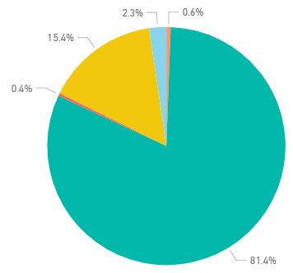
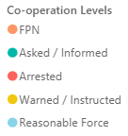
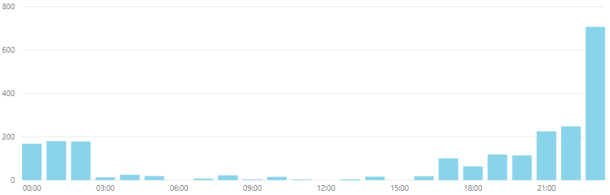
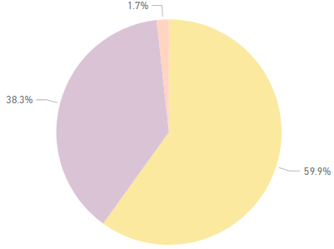

Weekly Legislation Co-operation (10th – 16th September 2020)
Weekly Cooperation Levels
Interaction Totals (Preceding Week)
An ‘interaction’ is any instance where a Police Officer has reason to engage with a person who is not conforming with Legislation. Only when all efforts to encourage co-operation fail will Police Officers resort to enforcement.
Weekly Intervention Locations
Interaction Times (Preceding Week)
In response to the introduction of The Health Protection (Coronavirus) (Restrictions) (Scotland) Regulations 2020 and Coronavirus Act 2020, Police Scotland developed a ‘Coronavirus Interventions’ (CVI) recording system. This system allowed Police Scotland to begin gathering data in relation to the public co-operation levels with the new legislation. This system relies on Police Officers manually updating the system with the co-operation level when they encounter an individual in contravention of the new legislation.
Due to the manual input required to form this data set, the contents of this slide are indicative only. Actual figures will differ from those recorded on Crime Systems (please see slide 11), may be subject to change, and cannot be considered Official Police Statistics. They do provide an indication of the public co-operation levels across Scotland.
No figures should be considered as Official Police Statistics. These may not yet have been verified or validated.

Slide 11
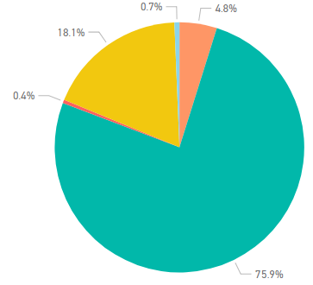
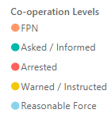
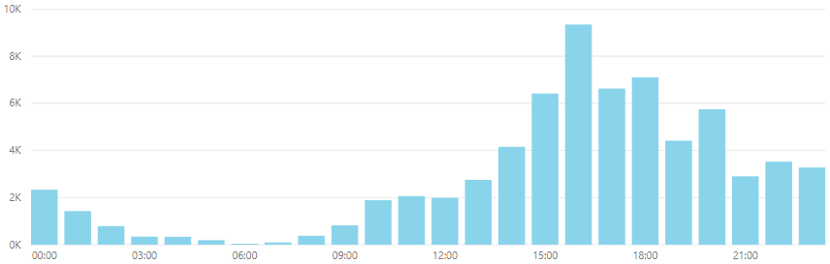
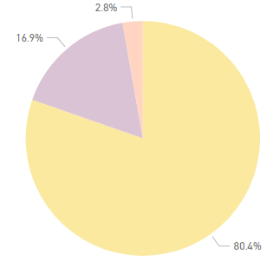
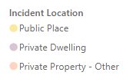
Coronavirus Legislation Co-operation (27th March – 16th September 2020)
All Time Cooperation Levels
Interaction Totals (All Time)
An ‘interaction’ is any instance where a Police Officer has reason to engage with a person who is not conforming with Legislation. Only when all efforts to encourage co-operation fail will Police Officers resort to enforcement.
All Time Intervention Locations
Interaction Times (All Time)
In response to the introduction of The Health Protection (Coronavirus) (Restrictions) (Scotland) Regulations 2020 and Coronavirus Act 2020, Police Scotland developed a ‘Coronavirus Interventions’ (CVI) recording system. This system allowed Police Scotland to begin gathering data in relation to the public co-operation levels with the new legislation. This system relies on Police Officers manually updating the system with the co-operation level when they encounter an individual in contravention of the new legislation.
Due to the manual input required to form this data set, the contents of this slide are indicative only. Actual figures will differ from those recorded on Crime Systems (please see slide 11), may be subject to change, and cannot be considered Official Police Statistics. They do provide an indication of the public co-operation levels across Scotland.
No figures should be considered as Official Police Statistics. These may not yet have been verified or validated.

Slide 12
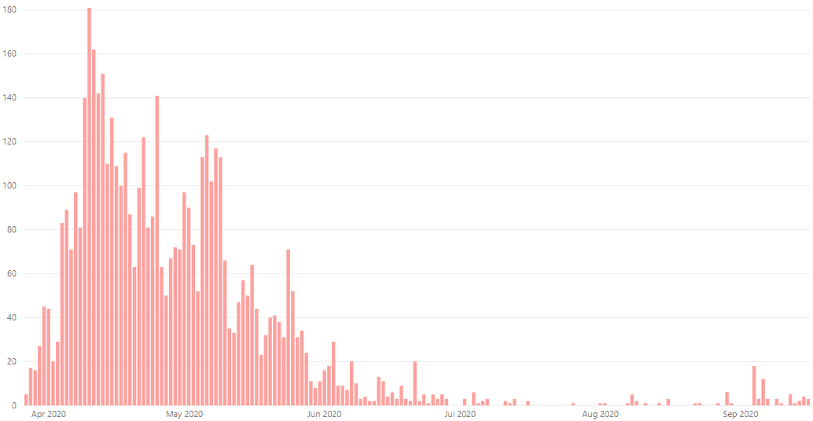
‘Enforcement’ of Coronavirus specific legislation
OFFICIAL
The following is a summary of all ‘enforcement’ action in relation to both The Health Protection (Coronavirus) (Restrictions) (Scotland) Regulations 2020 and Coronavirus Act 2020.
This includes all Fixed Penalty Notices issued and processed by Police Scotland. It also includes all occasions that a charge was libelled and recorded on Police Scotland’s Crime Recording System against a person in relation to the aforementioned legislation. This is a true value of the volume of recorded ‘enforcement’ activity, but does not provide the granularity of the Coronavirus Intervention (CVI) recording system and does not capture the earlier phases of the ‘4 E’s’ approach.
These values remain subject to change as offences are retrospectively added or amended and do not match the indicative ‘enforcement’ values from the CVI recording system.
Volume of Covid-19 Charges by Date
Total | Total |  |  |  |  |  |  |  |  |  |  |  |  |  |  |  |  |  |  |  |  |  |  |  |  | March | 27-Mar | 28-Mar | 29-Mar | 30-Mar | 31-Mar
2020 | 5018 |  |  |  |  |  |  |  |  |  |  |  |  |  |  |  |  |  |  |  |  |  |  |  |  | 2020 | 5 | 17 | 16 | 27 | 45
April | 01-Apr | 02-Apr | 03-Apr | 04-Apr | 05-Apr | 06-Apr | 07-Apr | 08-Apr | 09-Apr | 10-Apr | 11-Apr | 12-Apr | 13-Apr | 14-Apr | 15-Apr | 16-Apr | 17-Apr | 18-Apr | 19-Apr | 20-Apr | 21-Apr | 22-Apr | 23-Apr | 24-Apr | 25-Apr | 26-Apr | 27-Apr | 28-Apr | 29-Apr | 30-Apr
2020 | 44 | 20 | 29 | 83 | 89 | 71 | 97 | 81 | 140 | 181 | 162 | 142 | 151 | 110 | 131 | 109 | 100 | 115 | 87 | 63 | 99 | 122 | 81 | 86 | 141 | 63 | 50 | 67 | 72 | 71
May | 01-May | 02-May | 03-May | 04-May | 05-May | 06-May | 07-May | 08-May | 09-May | 10-May | 11-May | 12-May | 13-May | 14-May | 15-May | 16-May | 17-May | 18-May | 19-May | 20-May | 21-May | 22-May | 23-May | 24-May | 25-May | 26-May | 27-May | 28-May | 29-May | 30-May | 31-May
2020 | 97 | 90 | 73 | 52 | 113 | 123 | 102 | 117 | 113 | 66 | 35 | 33 | 47 | 57 | 50 | 64 | 44 | 23 | 32 | 40 | 41 | 38 | 31 | 71 | 52 | 31 | 34 | 24 | 11 | 8 | 11
June | 01-Jun | 02-Jun | 03-Jun | 04-Jun | 05-Jun | 06-Jun | 07-Jun | 08-Jun | 09-Jun | 10-Jun | 11-Jun | 12-Jun | 13-Jun | 14-Jun | 15-Jun | 16-Jun | 17-Jun | 18-Jun | 19-Jun | 20-Jun | 21-Jun | 22-Jun | 23-Jun | 24-Jun | 25-Jun | 26-Jun | 27-Jun | 28-Jun | 29-Jun | 30-Jun
2020 | 16 | 18 | 29 | 9 | 9 | 7 | 20 | 10 | 3 | 4 | 2 | 2 | 13 | 11 | 4 | 6 | 3 | 9 | 3 | 2 | 20 | 2 | 5 | 1 | 5 | 3 | 5 | 3 | 0 | 0
July | 01-Jul | 02-Jul | 03-Jul | 04-Jul | 05-Jul | 06-Jul | 07-Jul | 08-Jul | 09-Jul | 10-Jul | 11-Jul | 12-Jul | 13-Jul | 14-Jul | 15-Jul | 16-Jul | 17-Jul | 18-Jul | 19-Jul | 20-Jul | 21-Jul | 22-Jul | 23-Jul | 24-Jul | 25-Jul | 26-Jul | 27-Jul | 28-Jul | 29-Jul | 30-Jul | 31-Jul
2020 | 0 | 3 | 0 | 6 | 1 | 2 | 3 | 0 | 0 | 0 | 2 | 1 | 3 | 0 | 0 | 2 | 0 | 0 | 0 | 0 | 0 | 0 | 0 | 0 | 0 | 1 | 0 | 0 | 0 | 0 | 0
August | 01-Aug | 02-Aug | 03-Aug | 04-Aug | 05-Aug | 06-Aug | 07-Aug | 08-Aug | 09-Aug | 10-Aug | 11-Aug | 12-Aug | 13-Aug | 14-Aug | 15-Aug | 16-Aug | 17-Aug | 18-Aug | 19-Aug | 20-Aug | 21-Aug | 22-Aug | 23-Aug | 24-Aug | 25-Aug | 26-Aug | 27-Aug | 28-Aug | 29-Aug | 30-Aug | 31-Aug
2020 | 1 | 1 | 0 | 0 | 0 | 0 | 1 | 5 | 2 | 0 | 1 | 0 | 0 | 1 | 0 | 3 | 0 | 0 | 0 | 0 | 0 | 1 | 1 | 0 | 0 | 0 | 1 | 0 | 6 | 1 | 0
Sept | 01-Sep | 02-Sep | 03-Sep | 04-Sep | 05-Sep | 06-Sep | 07-Sep | 08-Sep | 09-Sep | 10-Sep | 11-Sep | 12-Sep | 13-Sep | 14-Sep | 15-Sep | 16-Sep
2020 | 0 | 0 | 0 | 18 | 3 | 12 | 3 | 0 | 3 | 1 | 0 | 5 | 1 | 2 | 4 | 3
No figures should be considered as Official Police Statistics. These may not yet have been verified or validated.

Slide 13
Weekly Absence (10th – 16th September 2020)
Weekly Absence Levels Line Graph – Comparison of 2019 to 2020
Police Scotland Current Absences
16th Sept 2020 | No. | Change from same day previous week | Change from same day previous week (%)
COVID-19 | 309 | +134 | +77%
Total Absences | 1191 | +145 | +14%
Date | 10-Sep | 11-Sep | 12-Sep | 13-Sep | 14-Sep | 15-Sep | 16-Sep
2020 | 1068 | 1085 | 1097 | 1097 | 1088 | 1184 | 1191
2019 | 1073 | 1102 | 1078 | 1095 | 1082 | 1078 | 1067
No figures should be considered as Official Police Statistics. These may not yet have been verified or validated.

Slide 14
Total Absence (18th March – 16th September 2020)
Total Absence Levels Line Graph – Comparison of 2019 to 2020
 |  |  |  |  |  |  |  |  |  |  |  |  |  |  |  |  | March | 18-Mar | 19-Mar | 20-Mar | 21-Mar | 22-Mar | 23-Mar | 24-Mar | 25-Mar | 26-Mar | 27-Mar | 28-Mar | 29-Mar | 30-Mar | 31-Mar
 |  |  |  |  |  |  |  |  |  |  |  |  |  |  |  |  | 2020 | 1424 | 1725 | 2587 | 2681 | 2765 | 2926 | 3238 | 3460 | 3619 | 3669 | 3731 | 3745 | 3716 | 3688
 |  |  |  |  |  |  |  |  |  |  |  |  |  |  |  |  | 2019 | 977 | 979 | 964 | 963 | 973 | 971 | 961 | 951 | 985 | 1018 | 1007 | 1006 | 993 | 994
April | 01-Apr | 02-Apr | 03-Apr | 04-Apr | 05-Apr | 06-Apr | 07-Apr | 08-Apr | 09-Apr | 10-Apr | 11-Apr | 12-Apr | 13-Apr | 14-Apr | 15-Apr | 16-Apr | 17-Apr | 18-Apr | 19-Apr | 20-Apr | 21-Apr | 22-Apr | 23-Apr | 24-Apr | 25-Apr | 26-Apr | 27-Apr | 28-Apr | 29-Apr | 30-Apr
2020 | 3562 | 3421 | 3330 | 3258 | 3214 | 3114 | 2992 | 2871 | 2823 | 2730 | 2653 | 2619 | 2548 | 2440 | 2376 | 2347 | 2333 | 2301 | 2292 | 2268 | 2175 | 2105 | 2069 | 2015 | 1981 | 1954 | 1926 | 1870 | 1815 | 1783
2019 | 987 | 995 | 983 | 985 | 976 | 965 | 968 | 978 | 993 | 1022 | 1006 | 1012 | 989 | 989 | 1000 | 1024 | 1024 | 1017 | 1006 | 993 | 988 | 981 | 992 | 988 | 1000 | 1000 | 988 | 984 | 963 | 978
May | 01-May | 02-May | 03-May | 04-May | 05-May | 06-May | 07-May | 08-May | 09-May | 10-May | 11-May | 12-May | 13-May | 14-May | 15-May | 16-May | 17-May | 18-May | 19-May | 20-May | 21-May | 22-May | 23-May | 24-May | 25-May | 26-May | 27-May | 28-May | 29-May | 30-May | 31-May
2020 | 1779 | 1720 | 1709 | 1686 | 1626 | 1550 | 1486 | 1385 | 1293 | 1266 | 1249 | 1217 | 1194 | 1182 | 1137 | 1102 | 1081 | 1072 | 1060 | 1053 | 1043 | 1058 | 1046 | 1026 | 1006 | 984 | 970 | 963 | 974 | 960 | 931
2019 | 973 | 981 | 986 | 999 | 987 | 1000 | 1022 | 1027 | 1037 | 1032 | 1030 | 1029 | 1025 | 1052 | 1054 | 1034 | 1031 | 1028 | 1023 | 1023 | 1058 | 1060 | 1062 | 1061 | 1071 | 1058 | 1044 | 1053 | 1069 | 1055 | 1044
June | 01-Jun | 02-Jun | 03-Jun | 04-Jun | 05-Jun | 06-Jun | 07-Jun | 08-Jun | 09-Jun | 10-Jun | 11-Jun | 12-Jun | 13-Jun | 14-Jun | 15-Jun | 16-Jun | 17-Jun | 18-Jun | 19-Jun | 20-Jun | 21-Jun | 22-Jun | 23-Jun | 24-Jun | 25-Jun | 26-Jun | 27-Jun | 28-Jun | 29-Jun | 30-Jun
2020 | 929 | 915 | 910 | 900 | 905 | 899 | 904 | 889 | 887 | 903 | 900 | 891 | 888 | 883 | 894 | 886 | 887 | 872 | 868 | 869 | 864 | 861 | 861 | 857 | 853 | 845 | 840 | 841 | 825 | 839
2019 | 1037 | 1043 | 1041 | 1038 | 1067 | 1062 | 1052 | 1049 | 1023 | 1023 | 1020 | 1032 | 1036 | 1052 | 1049 | 1043 | 1038 | 1054 | 1056 | 1044 | 1053 | 1038 | 1035 | 1019 | 1033 | 1057 | 1066 | 1069 | 1056 | 1036
July | 01-Jul | 02-Jul | 03-Jul | 04-Jul | 05-Jul | 06-Jul | 07-Jul | 08-Jul | 09-Jul | 10-Jul | 11-Jul | 12-Jul | 13-Jul | 14-Jul | 15-Jul | 16-Jul | 17-Jul | 18-Jul | 19-Jul | 20-Jul | 21-Jul | 22-Jul | 23-Jul | 24-Jul | 25-Jul | 26-Jul | 27-Jul | 28-Jul | 29-Jul | 30-Jul | 31-Jul
2020 | 823 | 826 | 831 | 842 | 832 | 815 | 801 | 806 | 810 | 819 | 823 | 818 | 810 | 809 | 808 | 798 | 811 | 794 | 787 | 796 | 800 | 802 | 804 | 814 | 809 | 806 | 801 | 821 | 826 | 831 | 867
2019 | 1019 | 1015 | 1021 | 1034 | 1035 | 1038 | 1036 | 1015 | 1015 | 1022 | 1006 | 1025 | 1012 | 1007 | 985 | 981 | 970 | 987 | 1001 | 981 | 980 | 974 | 981 | 1005 | 1015 | 999 | 974 | 975 | 972 | 983 | 996
August | 01-Aug | 02-Aug | 03-Aug | 04-Aug | 05-Aug | 06-Aug | 07-Aug | 08-Aug | 09-Aug | 10-Aug | 11-Aug | 12-Aug | 13-Aug | 14-Aug | 15-Aug | 16-Aug | 17-Aug | 18-Aug | 19-Aug | 20-Aug | 21-Aug | 22-Aug | 23-Aug | 24-Aug | 25-Aug | 26-Aug | 27-Aug | 28-Aug | 29-Aug | 30-Aug | 31-Aug
2020 | 838 | 835 | 804 | 806 | 804 | 811 | 814 | 810 | 822 | 822 | 811 | 821 | 836 | 829 | 830 | 824 | 819 | 846 | 866 | 878 | 913 | 913 | 908 | 898 | 994 | 1067 | 1074 | 1116 | 1151 | 1115 | 1059
2019 | 985 | 979 | 967 | 959 | 948 | 964 | 976 | 993 | 1025 | 1023 | 1019 | 1021 | 1023 | 1021 | 1037 | 1031 | 1027 | 1020 | 999 | 1004 | 1036 | 1054 | 1059 | 1058 | 1055 | 1051 | 1052 | 1072 | 1054 | 1072 | 1061
Sept | 01-Sep | 02-Sep | 03-Sep | 04-Sep | 05-Sep | 06-Sep | 07-Sep | 08-Sep | 09-Sep | 10-Sep | 11-Sep | 12-Sep | 13-Sep | 14-Sep | 15-Sep | 16-Sep
2020 | 1050 | 1059 | 1048 | 1051 | 1031 | 1038 | 1013 | 1018 | 1046 | 1068 | 1085 | 1097 | 1097 | 1088 | 1184 | 1191
2019 | 1047 | 1051 | 1063 | 1073 | 1075 | 1090 | 1083 | 1078 | 1061 | 1073 | 1102 | 1078 | 1095 | 1082 | 1078 | 1067
No figures should be considered as Official Police Statistics. These may not yet have been verified or validated.

Slide 15
Near Miss and Testing Data (w/e 23rd March – 14th September 2020)
‘Near miss’ forms in the context of the pandemic situation may be submitted for a variety of reasons. i.e. when officers are potentially exposed to: COVID-19 whilst not wearing PPE, where PPE malfunctions, or in any other instance an officer feels a risk to themselves in a specific occurrence relating to COVID-19.
This can occur due to the reactive nature of policing, as well as being influenced by training levels and supply of PPE. This number of ‘Near Miss’ weekly submissions has increased from the previous week.
The amount of forms submitted continues to be attributable to the process for requesting an asymptomatic COVID-19 screening test due to an occupational risk, requiring the submission of a ‘near miss’ form. Many of the reports would not have been submitted without this requirement. The number of incidents where a lack of PPE is identified has not risen.
No figures should be considered as Official Police Statistics. These may not yet have been verified or validated.

Slide 16
Testing Data (7th April – 16th September 2020)
Police Scotland Testing Data
Total Referrals |  | Tested Positive |  | Tested Negative |  | Inconclusive
Symptomatic Testing
1371 |  | 166 |  | 1065 |  | 22
Asymptomatic Testing
380 |  | 0 |  | 333 |  | 2
Contact Tracing
47 |  | 8 |  | 21 |  | 0
Other: Locally Arranged Tests
767 | 61 |  | 702 |  | 3
Locally arranged tests may refer to Divisional arrangements, self arranged tests or those arranged by the NHS.
*Work has been undertaken resulting in some duplication of results being corrected which has resulted in a drop, particularly with regards to self referral reporting data, of positive and some negative cases.
*Please note that individuals who are 'traced' are not always deemed suitable for testing and suitability is determined by the NHS. These tests are not arranged by Police Scotland. For those who have been tested within Phase 3, we have recorded the result accordingly.
*Please note Testing Data is now being reported weekly. The last Testing data report was received on 14th September 2020 and includes tests arranged up to and including 16th September 2020.
No figures should be considered as Official Police Statistics. These may not yet have been verified or validated.

Slide 17
Custody Volume
The below line graph displays the total custody volume over time. The number of custodies fell on the approach to ‘lockdown’, reaching their lowest level on 29th March. Since that date Custodies have steadily increased and now show a consistent pattern.
No figures should be considered as Official Police Statistics. These may not yet have been verified or validated.

