Slide 1
Auctioneers & Firearms Licensing
Good Practice Guide For
Auctioneers
July 2020

Slide 2
Good Practice Guide for Auctioneers
The expectation is that Auctioneers will use this guide to improve their understanding of the obligations placed on individuals or businesses who have the responsibility for administering an Auction in respect of the sales of firearms and ammunition.
Clearly if you are going to receive firearms for sale it is of the upmost importance that you satisfy yourself that all firearms are NOT loaded. You need to ensure that the initial examination of a firearm is carried out by some one who is suitably experienced/qualified to safely handle firearms and confirm they are SAFE.
This includes muzzle loading firearms.

Slide 3
Good Practice Guide for Auctioneers What the Law says
By virtue of Section 9 of Firearms Act 1968, as amended Auctioneers, Carriers & Warehousemen are exempt from the need to hold a firearm/shotgun certificate and can possess Section 1 & 2 firearms and ammunition in the course of their business. However, Section 14 of the Firearms (Amendment) Act 1988 also says:
It is an offence for an auctioneer, carrier or warehouseman—
(a) to fail to take reasonable precautions for the safe custody of any firearm or ammunition which, by virtue of section 9(1) of the principal Act, he or any servant of his has in his possession without holding a certificate;
or
(b) to fail to report forthwith to the police the loss or theft of any such firearm or ammunition

Slide 4
Auctioneers Permits
If you are an auctioneer which is NOT also registered as a Firearms Dealer you need to obtain an Auctioneers Permit from the police force in whose jurisdiction you wish to conduct the sale.
You will need to supply the full details including calibre, make and serial numbers of all firearms which you wish to offer for sale at auction including air weapons but excluding “Antique” firearms.
As previously stated you have an obligation to ensure the safe secure storage of the firearms and ammunition being offered for sale.
An Auctioneers permit would normally be issued for a period to cover any prior viewing of the lots offered for sale.
You must NOT complete the sale to a successful bidder without seeing their valid firearm or shotgun certificate authorising the acquisition of the
firearm concerned.

Slide 5
Antique Firearms
Section 126 of the Policing & Crime Act 2017 will for the first time set out in law the definition of a “Antique Firearm”
Unfortunately this part of the Policing & Crime Act has yet to come into law and until it does we have to rely on the advice set out in Chapter 8
of the Home Office Guide on Firearms Licensing Law.
A selection of the advice included in Chapter 8 of the Home Office Guide on Firearms Licensing Law is set out on the next slides

Slide 6
Old firearms which should benefit from exemption as antiques
Pre-1939 firearms to benefit from exemption as antiques are as follows:
All muzzle-loading firearms;
(b) Breech-loading firearms capable of discharging a rimfire cartridge other than .22 inch or .23 inch (or their metric equivalents), 6mm or 9mm rimfire;
(c) Breech-loading firearms using ignition systems other than rimfire and centrefire (these include pin-fire and needle-fire ignition systems, as well as the more obscure lip fire, cup-primed, teat fire and base fire systems);
(d) Breech-loading centrefire arms originally chambered for one of the obsolete cartridges listed in Appendix 5 and which retain their original chambering;
(e) Shotguns and punt guns chambered for the following cartridges (expressed in imperial measurements): 32 bore, 24 bore, 14 bore, 10 bore (2 and 2 inch only), 8 bore, 4 bore, 3 bore, 2 bore, 1 bore, 1 ¼ bore and 1 ½ bore, and vintage punt guns and shotguns with bores greater than 10. It also includes vintage (pre-1939) rifles in
these bores.

Slide 7
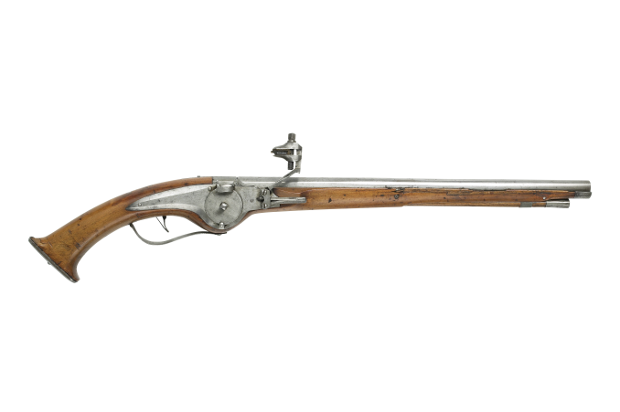
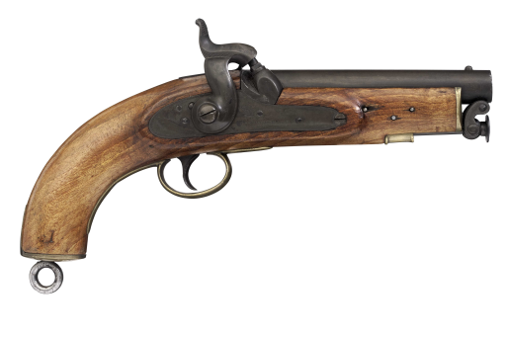
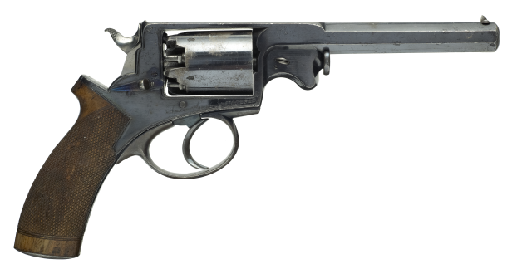
Old weapons which should benefit from exemption as antiques under section 58 (2) of the Firearms Act 1968
Those pre-1939 weapons to benefit from exemption:
All muzzle-loading firearms.
Wheellock pistol, German, about 1640
Coastguard pistol, 1849
Long Land pattern musket, 1731
Adams percussion revolver, 1865

Slide 8
Mechanisms
Wheellock
Percussion
Flintlock

Slide 9
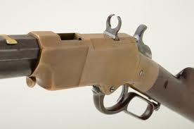
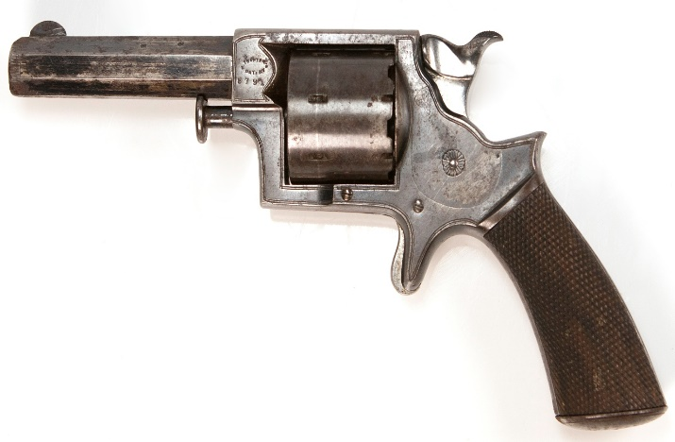
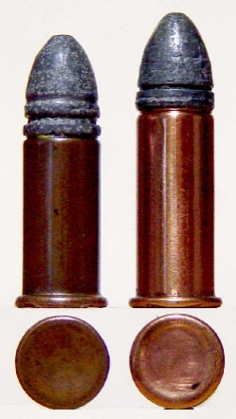
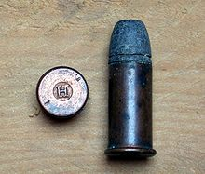
Old weapons which should benefit from exemption as antiques under section 58 (2) of the Firearms Act 1968
Those pre-1939 weapons to benefit from exemption
Breech-loading firearms capable of discharging a rimfire cartridge other than 4mm, 5mm, 6mm or 9mm rimfire and .22 in or .23 in (or their metric equivalents)
A .32” rimfire Tranter revolver, c.1865
.44 rimfire Henry rifle, 1860

Slide 10
Old weapons which should benefit from exemption as antiques under section 58 (2) of the Firearms Act 1968
Those pre-1939 weapons to benefit from exemption:
Breech-loading firearms using ignition systems other than rimfire and centrefire.
(These include such systems as needle-fire and pin-fire ignition systems, as well as the more obscure types such as lip-fire, cup-primed, teat-fire and base-fire systems)
Model 1857 Dreyse needle-fire rifle, German dated 1863

Slide 11
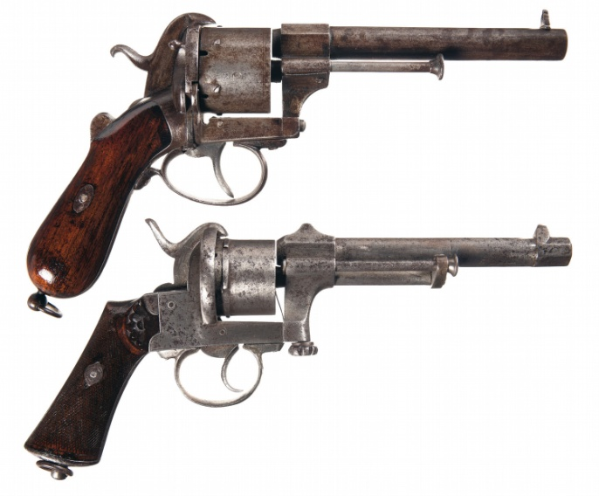
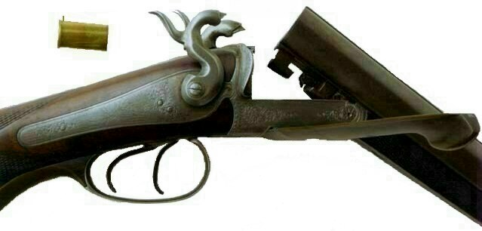
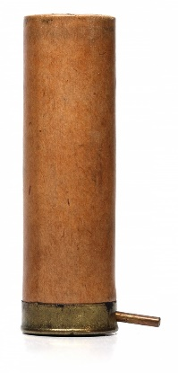
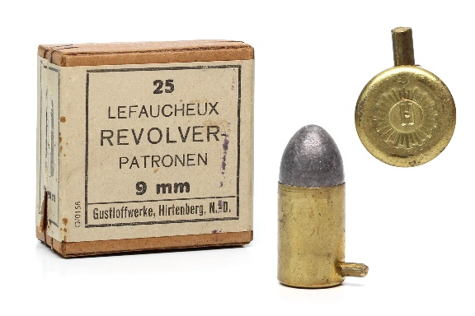
Pin fire shotgun, about 1870
Top:
French pinfire revolver, about 1860
Bottom;
Belgium pinfire revolver, by Mariette, about 1860
.

Slide 12
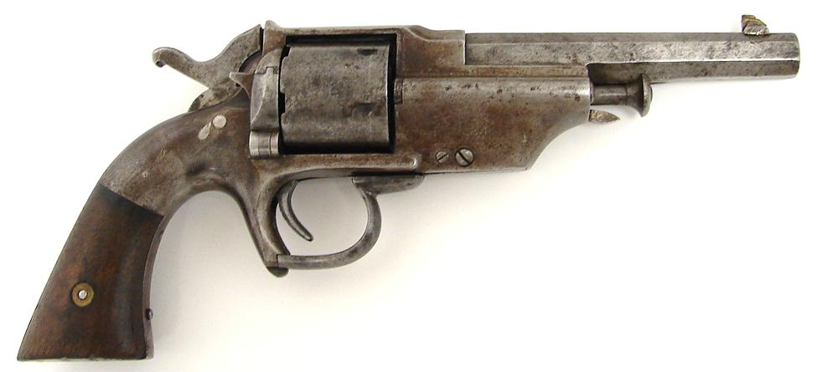
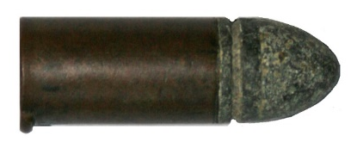
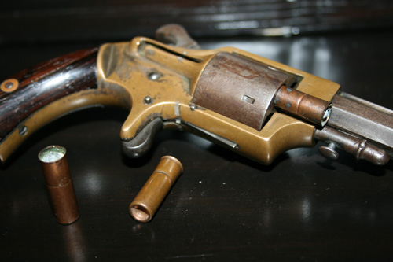
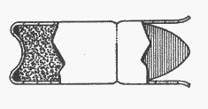
Lipfire cartridge
A .44” Allen and Wheellock lip-fire revolver
.30 cupfire by Merwin & May, USA, about 1855.
Cupfire cartridge

Slide 13
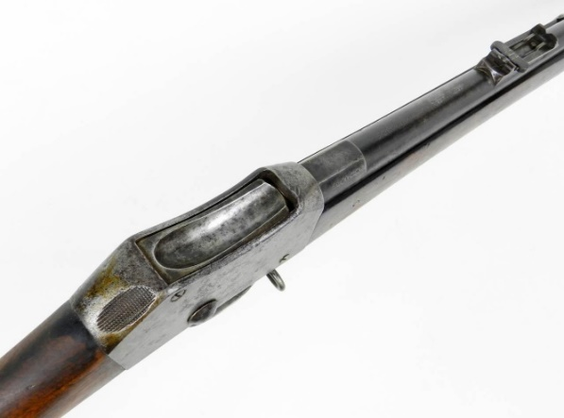
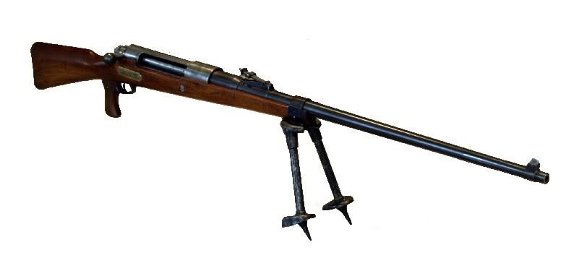
Old weapons which should benefit from exemption as antiques under section 58 (2) of the Firearms Act 1968
Those pre-1939 weapons to benefit from exemption:
Breech-loading centrefire arms originally chambered for one of the obsolete cartridges specified in the list and which retain their original chambering.
Martini-Henry rifle, .577-450 in.
British, about 1875
T-Gew anti-tank rifle, 13 x 92 mm.
German, 1918
The current list can be found here:
https://www.gov.uk/government/uploads/system/uploads/attachment_data/file/652724/List_of_obsolete_cartridges__Condoc_annex_2_.xlsx

Slide 14
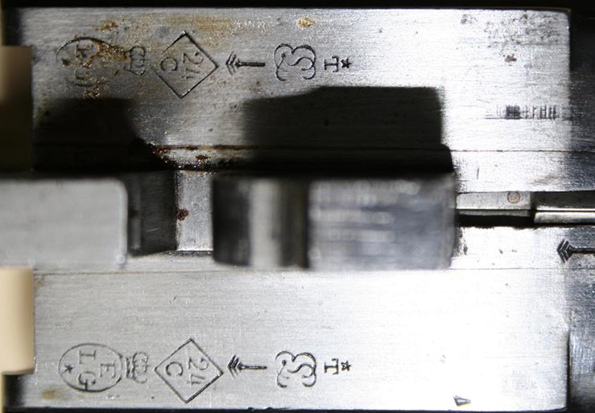
On the underside of the breech of most breech loading shotguns, particularly those made in the U.K., there will be proof marks, these can help identify an obsolete calibre.
When proved the bore, before 1937, would be stamped into a diamond which will help to identify obsolete calibre as listed in Statutory Instrument. Although this example bears Belgian proof marks it also used the diamond system and identifies this example as 24 bore and thus is deemed an antique since its maker terminated production before 1939.

Slide 15
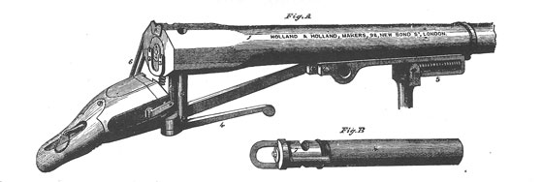
Old weapons which should benefit from exemption as antiques under section 58 (2) of the Firearms Act 1968
Those pre-1939 weapons to benefit from exemption
Shot guns and punt guns chambered for the following cartridges:
32 bore, 24 bore, 14 bore, 10 bore (2^{5/8} and 2^{7/8} inch only), 8 bore, 4 bore, 3 bore, 2 bore, 1^{1/8} bore, 1^{¼} bore and 1^{1/2} bore, and vintage punt guns and shot guns with bores greater than 10.
It also includes vintage (pre-1939) rifles in these same bores.
Holland & Holland 4 bore punt gun, about 1890
Rogers 8 bore rifle, about 1910

Slide 16
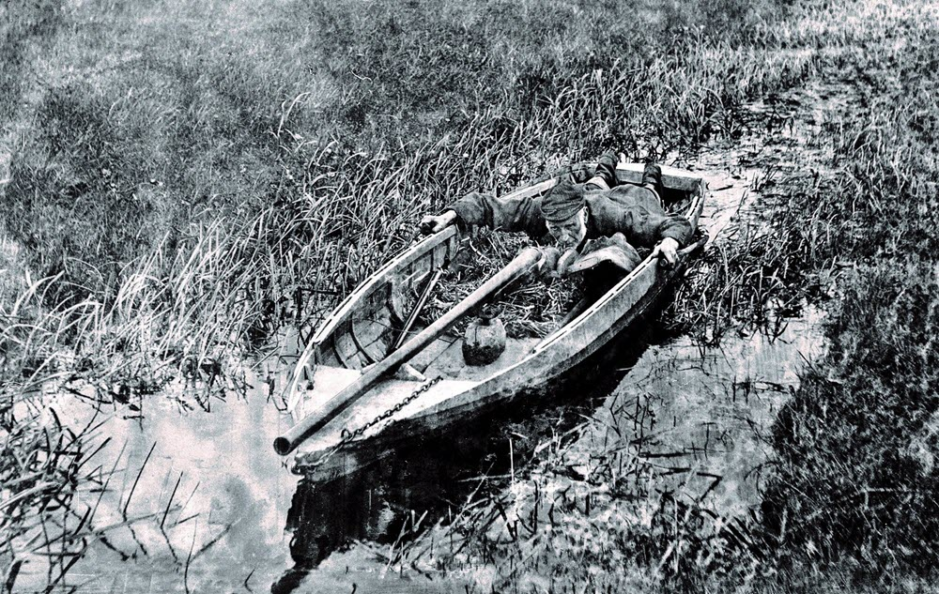
Punt guns

Slide 17
The exemption does not apply to ammunition, and the possession of live ammunition suitable for use with an otherwise antique firearm may indicate that the firearm is not possessed as a curiosity or ornament.
The exemption does not apply to firearms of modern manufacture which otherwise conform to the description above. For these purposes, “modern manufacture” should be taken to mean manufacture after the outbreak of the Second World War in 1939. Fully working modern firing replicas of muzzle-loading and breech-loading firearms, for example those used to fire blanks by historical re-enactment societies but capable of firing live ammunition, must be held on certificate. This includes replica pieces of ordnance that are to be fired; some replicas have been produced with a true bore size of just under 2 inches, thus enabling possession and use on a shotgun certificate, but with significant counter-boring at the muzzle to preserve the necessary appearance of external visual authenticity.

Slide 18
Old firearms which should not benefit from the exemption as antiques
Old firearms which should not benefit from the exemption as antiques are set out below. This list is not exhaustive and there may be other types and calibres of firearms that should be considered “modern” rather than “antique”:
Shotguns and smooth-bored guns, including shot pistols, chambered for standard shotgun cartridges, .22 inch, .23 inch, 6mm and 9mm rimfire cartridges unless otherwise specified in the list of obsolete shotgun chamberings in Appendix 5.
(b) Rifles and handguns chambered for.22 inch, .23 inch, 6mm or 9mm rimfire ammunition;
(c) Revolvers, single-shot pistols and self-loading pistols which are chambered for, and will accept centrefire cartridges of the type .25, .30, .32, .38, .380, .44, .45, .450, .455 and .476 inch, or their metric equivalents including 6.35mm, 7.62mm, 7.63mm, 7.65mm, 8mm and 9mm, unless otherwise specified in the list in Appendix 5;
(d) Modern reproduction firearms or old firearms which have been modified to allow the use of shotgun cartridges or cartridges not listed in Appendix 5;
(e) Weapons extensively modified after 1939;
(f) Signalling pistols chambered for 1 and 1 ½ inch cartridges or 26.5mm/27mm cartridges;
(g) Pump-action and self-loading centrefire rifles, except those examples originally chambered for one of the obsolete cartridges listed at Appendix 5 and retaining their original chamberings. The latter may benefit from an exemption as antiques under section 58(2) of the 1968 Act (as amended).

Slide 19
Advertising Firearms & Ammunition for Sale
It is very important that when advertising firearms and ammunition for sale that you it make clear in the advert the classification of the item and whether a firearm or shotgun certificate is required to authorise the sale to take place.
If you are not sure of the classification of a firearm or ammunition it should NOT be included in the auction.

Slide 20
Security
It is of the upmost importance that firearms and ammunition dealt with in the course of your business are stored securely to prevent unauthorised access.
Advice on security is set out in the Home Office Security Handbook 2019 which is available online at the GOV.UK website
Should you wish to make significant changes to the security arrangements previously inspected by the police you should in the first instance liaise with your Firearms Licensing Department.

Slide 21
The Definition of Firearms
Section 57 (1) of the 1968 Act (amended in 2017) defines firearms as follows;
a lethal barrelled weapon
a prohibited weapon;
a relevant component part in relation to a lethal barrelled weapon or a prohibited weapon;
an accessory to a lethal barrelled weapon or a prohibited weapon where the accessory is designed or adapted to diminish the noise or flash caused by firing the weapon (only so far as Section 1 and Section 5 prohibited weapons are concerned. Shotgun and air weapon moderators whilst subject to dealer recording requirements, are not subject to certification in England and Wales).
Section 57(1B) defines “lethal barrelled weapon” as a “barrelled weapon of any description from which a shot, bullet or other missile, with kinetic energy of more than one joule at the muzzle of the weapon, can be discharged”
(This includes air weapons).

Slide 22
Section 57 (1D) defines “relevant component part” in relation to a lethal barrelled weapons as follows;
a barrel, chamber or cylinder,
a frame, body or receiver,
a breech block, bolt or other mechanism for containing the pressure of discharge at the rear of a chamber.

Slide 23
Section 57A exempts “airsoft guns” that are “designed to discharge only a small plastic missile (whether or not it is also capable of discharging any other kind of missile)” where they do not exceed the “permitted kinetic energy level” and the “small plastic missile” is -
made wholly or partly from plastics
is spherical, and
does not exceed 8 millimetres in diameter.
The ‘permitted kinetic energy levels’ for airsoft guns are;
“in the case of a weapon which is capable of discharging two or more missiles successively without repeated pressure on the trigger, 1.3 joules”;
“in any other case, 2.5 joules”. (i.e. single shot/semi auto)

Slide 24
Air Weapon
In Scotland owners of Air Weapons require a certificate
An air weapon (that is to say, an air rifle, air gun or air pistol) which is not a prohibited weapon, and which is not of a type declared ‘specially dangerous’ by rules made by the Secretary of State.
The Firearms (Dangerous Air Weapons) Rules 1969 (as amended in 1993) sets the upper kinetic energy threshold (measured from the muzzle) for which air weapons (including weapons disguised as another object) remain exempt from certification;
In the case of an air pistol, 6ft. lb.
In the case of an air weapon other than an air pistol, 12ft. lb.
These energy levels do not apply to a weapon which is designed for use only when submerged in water.

Slide 25
The Administration of Firearm and Shotgun Certificates
It is essential that as an Auctioneer or RFD you understand the obligations placed upon you when transferring firearms (including shotguns) and ammunition to respective certificate holders.
You must comply with the instructions on a firearm or shotgun certificate whilst making a transaction entry and notifying a transaction to the relevant Police Force.
With firearm certificates it is very important you are aware that there must be an unused authority present on the certificate authorising the type of firearm, Section 1 component part, or accessory before the transfer can be completed. Equally the correct calibre and quantity of ammunition to be transferred is authorised by the buyer’s firearm certificate.
Note: Accessory in relation to firearm certificates means detachable sound moderators and flash hiders.

Slide 26
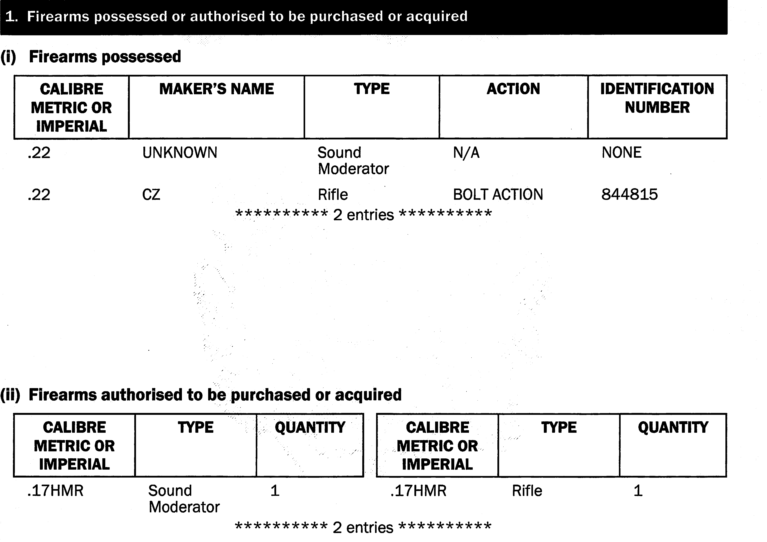
The Administration of Firearm and Shotgun Certificates
This FAC has two Authorised slots, so only those firearms, accessories can be sold.

Slide 27
The Administration of Firearm and Shotgun Certificates
It is illegal to complete a sale (accept full payment) for a firearm, Section 1 component part or accessory or shotgun to a person who cannot produce a firearm or shotgun certificate authorising them to acquire the firearm etc.
You may only take a deposit on a purchase prior to sight of the relevant certificate giving authority to purchase the firearm.
When selling air weapons, their component parts and accessories you must ensure they only sold to persons who are at least 18 years old.

Slide 28
Keeping of Records of Transactions
The Firearms Act 1968, as amended does not require an Auctioneer to keep records.
However, it is strongly recommended that Auctioneers follow the requirements of Section 40 (Schedule 4) of the Firearms Act 1968 (as amended) which requires a Firearms Dealer to keep records of transactions involving firearms, component parts and ammunition (this includes air weapons).
Therefore it is recommended that all firearms and ammunition (excluding Section 2 shot gun ammunition and air gun pellets) dealt with in the course of your business be recorded in a register of transactions.
Note: sound moderators for air weapons should also be recorded in the register of transactions.
It is recommended that records of transactions be kept for five years.

Slide 29
Keeping of Records of Transactions
It is recommended that you follow the requirements set out in Section 40 (1) which requires every person who by way of trade or business, manufactures, sells or transfers firearms, shotguns or ammunition to which section 1 of the Act applies, to keep a register of transactions and to enter therein the particulars specified in schedule 4 of the Act
Section 40 (1) Schedule 4: Details to be entered by registered firearms dealers in register of transactions:
The quantities and description of firearms and ammunition manufactured and the dates thereof.
The quantities and description of firearms and ammunition purchased or acquired with the names and addresses of the sellers or transferors and the dates of the transactions.
The quantities and description of firearms and ammunition accepted for sale, repair, test, proof, cleaning, storage, destruction or other purpose; with the names and addresses of the transferors and the dates of the transactions.
The quantities and description of firearms and ammunition sold or transferred with the names and addresses of the purchasers or transferees and, (except in cases where the purchaser or transferee is a registered firearms dealer) the areas in which the firearms were issued, and the dates of the transactions.
The quantities and description of firearms and ammunition in possession for sale or transfer at the date of the last stocktaking or other such date in each year as may be specified in the register.

Slide 30
Receipt of Firearms & Ammunition from Non-Certificate Holders
Where firearms are transferred to you by non-certificate holders, as well as recording the details of the firearms and ammunition surrendered, it is strongly advisable to notify your local police of the details of the surrendered firearm or ammunition. You should inform the police of the circumstances which led to the firearm or ammunition being left with you.
Where a person wishes to transfer a prohibited firearm to an Auctioneer who is not authorised to possess such items, it is strongly recommended that you take possession of the prohibited firearm. You should record the details of the firearm and how it came to be in your possession.
You must notify the Police immediately to make arrangements for the firearm to be collected from you.

Slide 31
Warning Prohibited Firearms possessed by virtue of Firearm/Shotgun Certificates
Auctioneers should be aware that although there are exemptions for firearm and shotgun certificate holders which allow them to possess various prohibited firearms such as walking stick guns, short firearms ( shot pistols & handguns) and Self Contained Gas Cartridge firearms, the exemptions do not extend to Auctioneers who need to be separately authorised by the Home Office to take possession of these prohibited firearms (Section 5 Authority).
It is clearly helpful that your records have a clear audit trail for all firearms and ammunition recorded in it.

Slide 32
Young Persons
The possession of firearms by young people is complicated; therefore for ease of reference Chapter 7 & Appendix 4 of the Home Office Guide on Firearms Licensing Law provides full guidance. https://www.gov.uk/government/publications/firearms-law-guidance-to-the-police-2012
A firearm certificate may only be granted to a person aged 14 years or older. A shotgun certificate can be granted to persons of any age. It is important to pay attention to the date of birth shown on the certificate prior to making any transfer.
A person under eighteen is prohibited by section 22 of the 1968 Firearms Act (as amended by the Violent Crime Reduction Act 2006 and the Firearms (Amendment) Regulations 2010 (SI 2010/1759)) from purchasing or hiring any firearm or ammunition defined by section 57. Section 24A(1) of the 1968 Act also prohibits the purchase of imitation firearms by those under the age of eighteen.
This includes:
air weapons and ammunition for air weapons;
imitation firearms, realistic imitation firearms and deactivated firearms;
readily convertible replicas (as defined by section 1 of the Firearms Act 1982);
smooth-bore guns;
shotgun cartridges;
blank ammunition.

Slide 33
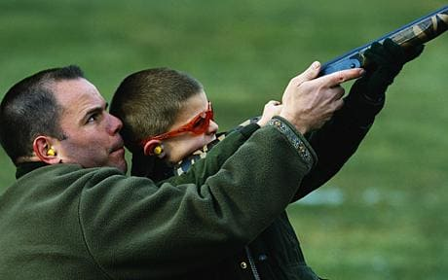
Young Persons
Section 24 makes it an offence for a person (including auctioneer) to sell firearms and ammunition to those under the age of eighteen. Section 24A(2) makes it an offence to sell imitation firearms to a person under the age of eighteen.
Young persons (under 18’s) may however acquire, other than by purchase or hire, air weapons (and air weapon ammunition), shotguns or shotgun cartridges to which section 2 applies, and firearms or ammunition to which section 1 of the 1968 Act applies according to the provisions laid out in the Home Office Guide on Firearms Licensing Law.
An example of acquisition would be using a firearm under the supervision of a parent or guardian (provided they are of the correct age) or a firearm certificate holder aged 14 to 17 acquiring rifle ammunition from a parent or other adult certificate holder as a gift. For shotguns and cartridges young people may only be gifted them from the age of 15.
http://i.telegraph.co.uk/multimedia/archive/01715/shotgun_1715954c.jpg

Slide 34
Carriers
It is also very important that due diligence is taken when making arrangements for the transportation of firearms.
If you intend to transport firearms and ammunition yourself it is very important that reasonable precautions are taken to ensure there is no unauthorised access to the firearms & ammunition. Please consult the Home Office Security Handbook 2019.
By virtue of Section 9 of Firearms Act 1968, as amended. Carriers are exempt from the need to hold a firearm/shotgun certificate and can possess Section 1 & 2 firearms and ammunition in the course of their business. However, Section 14 of the Firearms (Amendment) Act 1988 obligates the carrier to take reasonable precautions to ensure the security of all firearms or ammunition.
The transportation of prohibited firearms and ammunition can only be undertaken by Carriers who have been specifically authorised by the Home Office. (Section 5 Transport Authority Holders)

Slide 35
Remote Sales
“Remote” sales are those sales made when a
Registered Firearms Dealer (RFD) or Auctioneer sells a firearm or shotgun to a purchaser who is not present at the moment of sale and wants the newly acquired firearm or shot gun sent to another RFD for collection.

Slide 36
Seller (Auctioneer), must see the purchaser’s firearm or shotgun certificate before the sale is undertaken.
Having checked the certificate, Auctioneer fills in the necessary details and returns the Certificate to the purchaser.
RFD no.2 will receive the firearm/shotgun and make an appropriate entry on his register within 24 hours. He will then contact the purchaser who will present him or herself to RFD no.2 with his completed Certificate and take possession of the firearm/shotgun, as per the instructions on the purchaser’s Certificate.
Auctioneer will arrange for the firearm/shotgun to be sent to RFD no.2, and keep a record of the transaction.
The record of the transaction will say:
“sold to Mr/Mrs ..xx.. Certificate no…xx… and forwarded to RFD no.2 for collection”
Having paid the Auctioneer, the purchaser nominates a dealer (RFD no.2) in a location, remote from Auctioneer, where the purchaser wishes to take possession of the firearm/shotgun.
Auctioneer then notifies the Chief Officer of Police who issued the purchaser’s Certificate within 7 days of the sale. The notification must include a description of the firearm/shotgun
The purchaser must notify the Chief Officer of Police who issued his certificate, of the transfer within 7 days.
RFD no.2 will record ‘the transfer’ in the ‘Out’ section of his register within 24 hours of the transaction taking place

Slide 37
Servants
As an Auctioneer you may wish to employ or make use of servants to assist in the running of your business and it is important that due diligence is exercised so as to ensure that public safety is not compromised.
In order to fully satisfy yourself that there are no grounds for concern in respect of prospective employees or servants, it is recommended that you notify your local Police of the details (full name, date of birth, place of birth & home address) of any person you wish to act a servant by virtue of Section 9 (1) of the Firearms Act, 1968 as amended.

Slide 38
Controls on the Transfer/Sale of De-activated Firearms
2 May 2017: Section 128 – Policing & Crime Act 2017 introduced controls on the transfer of defectively deactivated weapons
28 June 2018: Revised EU Implementing Regulation affecting deactivated firearms
On 28 June 2018 came into effect. EU Commission Implementing Regulation 2018/337 introduces changes affecting deactivation standards within EU Member States. This revised the Implementing Regulation 2015/2403 which was previously introduced on 8th April 2016.
The new Implementing Regulations 2018/337 introduce revised technical de-activation specifications replacing those introduced in the 2015/2403 regulations.

Slide 39
Summary of Controls placed on the Sale/Transfer/Gifting of Deactivated Firearms
In order to be able to lawfully sell/transfer/gift a deactivated firearm it has to comply with the most recent (28 June 2018) EU implementation regulations 2018/337
The Sale/Transfer/Gift can only take place if the deactivated firearm is accompanied by a deactivation certificate confirming compliance with the 28 June 2018 EU implementation regulations.
It should be noted that these control do not apply to transfer/sale or gift to someone outside the EU or to Museums.

Slide 40
IF YOU HAVE ANY DOUBTS YOU CAN SEEK CLARIFICATION FROM YOUR LOCAL FIREARMS LICENSING DEPARTMENT.

