Slide 1
CoVID-19 WEEKLY Bulletin
3rd December – 9th December 2020
No figures should be considered as Official Police Statistics. These may not yet have been verified or validated.

Slide 2
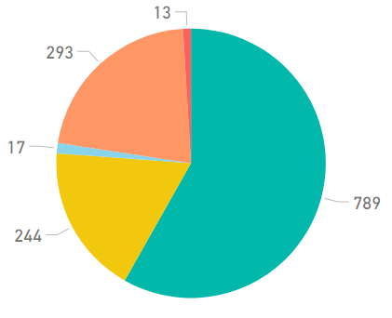
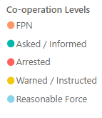
Service Centre Demand
Crime
Crime Volume (9 March – Present compared to Previous Year)
Crime has continued to trend at levels lower than the seasonal average, and total crime volume year to date continues to remain lower (6%) than last year.
7913 Offences under COVID Legislation
Recorded COVID Charges are pulled from Police Scotland CRIME systems rather than CVI. Enforcement activity includes Fixed Penalty Notices and offences recorded on Police Scotland’s Crime Recording System
Coronavirus Legislation
The volume of 101 and 999 calls answered showed consistent levels for most of the week however 101 calls show a reduction between 5th – 6th Dec.
Co-operation with new Coronavirus Legislation
The below chart is indicative of the co-operation levels experienced by police over the last 7 days. The majority of interactions between police and the public continue to be resolved without enforcement.
Crime Group Breakdown Change from previous year
Group 1 | Group 2 | Group 3 | Group 4 | Group 5
-7% | -5% | -16% | -10% | +9%
379244
2019
356754
2020
Incident volume throughout the last week was approximately 12% lower when compared to the same time last year.
Incident Demand
Quarantine Referrals to 9th December
Public Health Scotland Travel Regs. Referrals | 2630
Investigated by Resolution Team | 581
Investigated by Local Policing | 502
Investigations Ongoing | 0
Weeded prior to investigation | 1547
Absence
Gatherings in Private Dwellings
From 28/08/2020 – 09/12/2020
5460 Attended reports of House Party
3060 House Parties Dispersed
Travel Reg. offences resulting in FPN or SPR | 14
Absences throughout the week continues to trend above levels when compared to 2019.
Note: The referral figures are a count of reports submitted to Police Scotland. These will therefore vary from counts of the number of individuals.
FPNs may be derived from PHS, Home Office Referrals or from operational incidents.
.
Date of Highest
% Change from dates
No figures should be considered as Official Police Statistics. These may not yet have been verified or validated.
OFFICIAL

Slide 3
Weekly Service Centre Demand (3rd – 9th December 2020)
 | 03-Dec | 04-Dec | 05-Dec | 06-Dec | 07-Dec | 08-Dec | 09-Dec | Total
2020 101 Ans | 3705 | 3977 | 3735 | 3432 | 3962 | 3840 | 2853 | 25,504
2020 999 Ans | 1369 | 1666 | 1801 | 1367 | 1293 | 1212 | 1255 | 9,963
2019 101 Ans | 4,117 | 4,051 | 4,046 | 3,935 | 3,808 | 3,396 | 4,012 | 27,365
2019 999 Ans | 1526 | 1586 | 1714 | 1949 | 2151 | 2276 | 1786 | 12,988
No figures should be considered as Official Police Statistics. These may not yet have been verified or validated.

Slide 4
Weekly Incident Demand (3rd – 9th December 2020)
No figures should be considered as Official Police Statistics. These may not yet have been verified or validated.

Slide 5
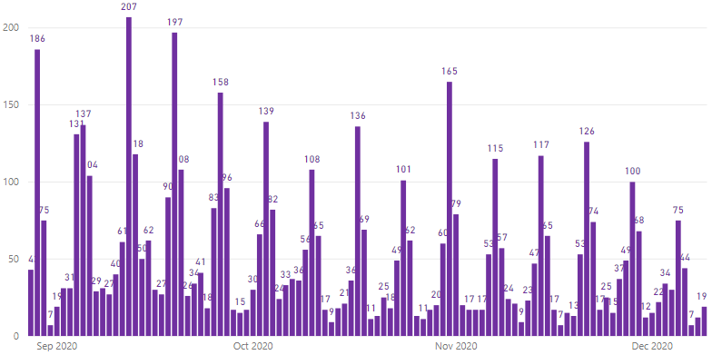
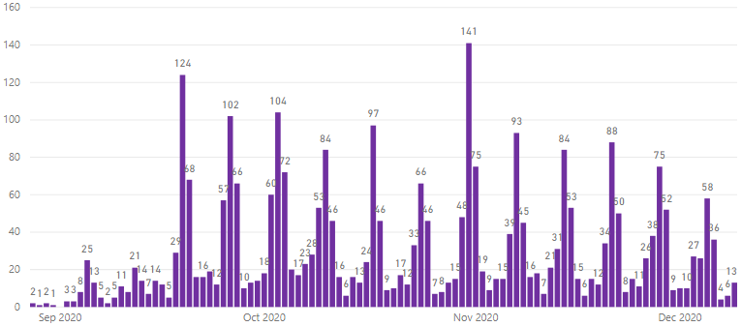
Incident Demand – House Gatherings (28th August – 6th December 2020)
From Friday 28th August 2020, additional monitoring of ‘house gatherings’ incidents has taken place. This will be reported weekly going forward.
Attended ‘House Gatherings’ Incidents
Attended ‘House Gatherings’ Breaching Restrictions
Totals | 28 Aug – 9 Dec | 3 – 9 Dec
No. of House Gatherings Attended | 5460 | 221
No. of House Gatherings Breaching Restrictions | 3060 | 170
No. of FPNs issued | 2650 | 306
No. of Arrests | 181 | 12
The figures contained within this slide originate from storm incident reviews and free-text local policing returns to provide the most comprehensive view of house gatherings possible.
Note: No figures should be considered as Official Police Statistics. These may not yet have been verified or validated.

Slide 6
Weekly Crime Demand (30th November – 6th December 2020)
Crime Group | 1 | 2 | 3 | 4 | 5 | 6 | 7 | Total
2019/20 | 160 | 239 | 2134 | 845 | 1252 | 2345 | 2384 | 9359
2020/21 | 137 | 224 | 1809 | 776 | 1130 | 1981 | 1622 | 7679
All Crime Groups show a decrease in volume when the preceding weeks volume is compared to the same period in 2019.
The majority of divisions this week have noted a decrease in crime volumes, however, Forth Valley, Fife, Fife and Dumfries and Galloway show an increase.
More information regarding Crime Groups can be found via this link
No figures should be considered as Official Police Statistics. These may not yet have been verified or validated.

Slide 7
Cumulative Crime Demand (16th March – 6th December 2020)
Crime Group | 1 | 2 | 3 | 4 | 5 | 6 | 7 | Total
2019/20 | 7158 | 10354 | 84278 | 36528 | 49915 | 99434 | 91577 | 379244
2020/21 | 6644 | 9844 | 70409 | 32802 | 54347 | 97290 | 85418 | 356754
All Crime Groups (with the exception of Group 5) show a decrease in volume when compared to the same period in 2019.
All Divisions continue to show a cumulative decrease in volume when compared to the same time period in 2019.
More information regarding Crime Groups can be found via this link
No figures should be considered as Official Police Statistics. These may not yet have been verified or validated.

Slide 8
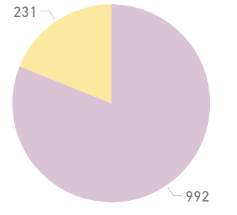
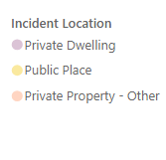
Weekly Legislation Co-operation (3rd December – 9th December)
Weekly Cooperation Levels
Interaction Totals (Preceding Week)
An ‘interaction’ is any instance where a Police Officer has reason to engage with a person who is not conforming with Legislation. Only when all efforts to encourage co-operation fail will Police Officers resort to enforcement.
Weekly Intervention Locations
Interaction Times (Preceding Week)
In response to the introduction of The Health Protection (Coronavirus) (Restrictions) (Scotland) Regulations 2020 and Coronavirus Act 2020, Police Scotland developed a ‘Coronavirus Interventions’ (CVI) recording system. This system allowed Police Scotland to begin gathering data in relation to the public co-operation levels with the new legislation. This system relies on Police Officers manually updating the system with the co-operation level when they encounter an individual in contravention of the new legislation. This slide includes all offence types – Face-Coverings, Quarantine, Travel Restrictions and Gatherings.
Due to the manual input required to form this data set, the contents of this slide are indicative only. Actual figures will differ from those recorded on Crime Systems (please see slide 11), may be subject to change, and cannot be considered Official Police Statistics. They do provide an indication of the public co-operation levels across Scotland.
No figures should be considered as Official Police Statistics. These may not yet have been verified or validated.

Slide 9
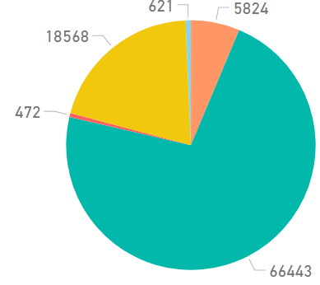
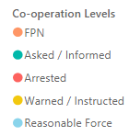
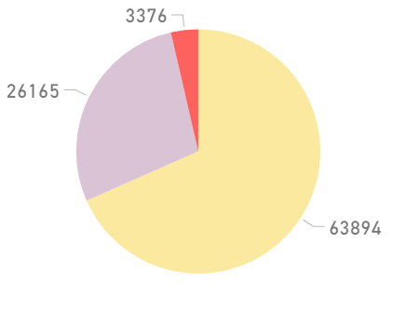
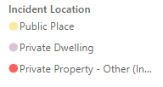
Coronavirus Legislation Co-operation (27th March – 9th December 2020)
All Time Cooperation Levels
Interaction Totals (All Time)
An ‘interaction’ is any instance where a Police Officer has reason to engage with a person who is not conforming with Legislation. Only when all efforts to encourage co-operation fail will Police Officers resort to enforcement.
All Time Intervention Locations
Interaction Times (All Time)
In response to the introduction of The Health Protection (Coronavirus) (Restrictions) (Scotland) Regulations 2020 and Coronavirus Act 2020, Police Scotland developed a ‘Coronavirus Interventions’ (CVI) recording system. This system allowed Police Scotland to begin gathering data in relation to the public co-operation levels with the new legislation. This system relies on Police Officers manually updating the system with the co-operation level when they encounter an individual in contravention of the new legislation. This slide includes all offence types – Face-Coverings, Quarantine, Travel Restrictions and Gatherings.
Due to the manual input required to form this data set, the contents of this slide are indicative only. Actual figures will differ from those recorded on Crime Systems (please see slide 11), may be subject to change, and cannot be considered Official Police Statistics. They do provide an indication of the public co-operation levels across Scotland.
No figures should be considered as Official Police Statistics. These may not yet have been verified or validated.

Slide 10
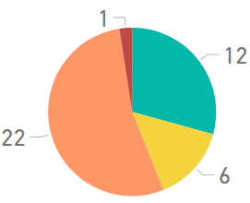
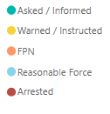
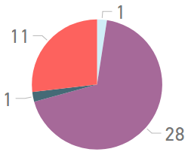
Weekly Travel Regulation Co-operation (3rd - 9th December 2020)
Weekly Cooperation Levels
CVI Activity by Date
An ‘interaction’ is any instance where a Police Officer has reason to engage with a person who is not conforming with Legislation. Only when all efforts to encourage co-operation fail will Police Officers resort to enforcement.
Weekly Intervention by Tier
CVI Interaction Times
In order to report upon policing interventions in respect of the newly introduced Travel Regulations regarding travel to or from tiers 3 and 4, the CVI system has been updated. The above data is a sub-set of the wider CVI interventions reported on the previous slides and should not be considered as ‘in addition to’ the previous overall CVI activity slides.
In response to the introduction of The Health Protection (Coronavirus) (Restrictions) (Scotland) Regulations 2020 and Coronavirus Act 2020, Police Scotland developed a ‘Coronavirus Interventions’ (CVI) recording system. This system allowed Police Scotland to begin gathering data in relation to the public co-operation levels with the new legislation. This system relies on Police Officers manually updating the system with the co-operation level when they encounter an individual in contravention of the new legislation.
Due to the manual input required to form this data set, the contents of this slide are indicative only. Actual figures will differ from those recorded on Crime Systems (please see slide 11), may be subject to change, and cannot be considered Official Police Statistics. They do provide an indication of the public co-operation levels across Scotland.
No figures should be considered as Official Police Statistics. These may not yet have been verified or validated.

Slide 11
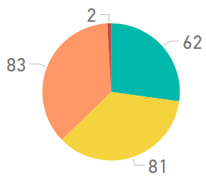
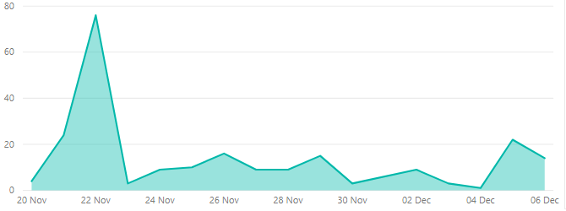
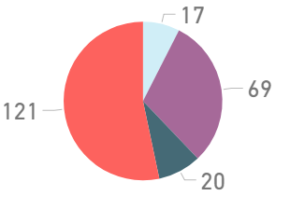
Travel Regulation Co-operation (20th November – 9th December 2020)
Cooperation Levels
CVI Activity by Date
An ‘interaction’ is any instance where a Police Officer has reason to engage with a person who is not conforming with Legislation. Only when all efforts to encourage co-operation fail will Police Officers resort to enforcement.
Intervention by Tier
CVI Interaction Times
In order to report upon policing interventions in respect of the newly introduced Travel Regulations regarding travel to or from tiers 3 and 4, the CVI system has been updated. The above data is a sub-set of the wider CVI interventions reported on the previous slides and should not be considered as ‘in addition to’ the previous overall CVI activity slides.
In response to the introduction of The Health Protection (Coronavirus) (Restrictions) (Scotland) Regulations 2020 and Coronavirus Act 2020, Police Scotland developed a ‘Coronavirus Interventions’ (CVI) recording system. This system allowed Police Scotland to begin gathering data in relation to the public co-operation levels with the new legislation. This system relies on Police Officers manually updating the system with the co-operation level when they encounter an individual in contravention of the new legislation.
Due to the manual input required to form this data set, the contents of this slide are indicative only. Actual figures will differ from those recorded on Crime Systems (please see slide 11), may be subject to change, and cannot be considered Official Police Statistics. They do provide an indication of the public co-operation levels across Scotland.
No figures should be considered as Official Police Statistics. These may not yet have been verified or validated.

Slide 12
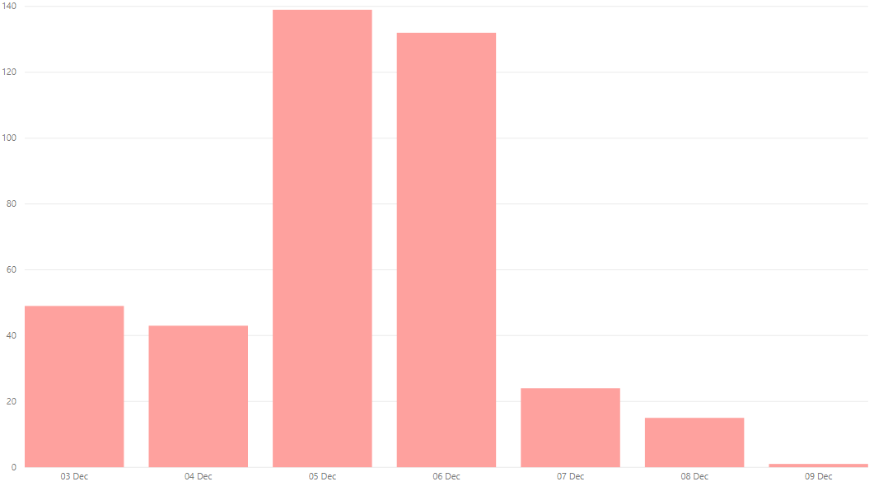
‘Enforcement’ of Coronavirus specific legislation
OFFICIAL
The following is a summary of all ‘enforcement’ action in relation to both The Health Protection (Coronavirus) (Restrictions) (Scotland) Regulations 2020 and Coronavirus Act 2020.
This includes all Fixed Penalty Notices issued and processed by Police Scotland. It also includes all occasions that a charge was libelled and recorded on Police Scotland’s Crime Recording System against a person in relation to the aforementioned legislation. This is a true value of the volume of recorded ‘enforcement’ activity, but does not provide the granularity of the Coronavirus Intervention (CVI) recording system and does not capture the earlier phases of the ‘4 E’s’ approach.
These values remain subject to change as offences are retrospectively added or amended and do not match the indicative ‘enforcement’ values from the CVI recording system.
Volume of Covid-19 Charges from 3rd December – 9th December 2020
Charges over the last 7 days | 403
Total Charges To Date | 7913
No figures should be considered as Official Police Statistics. These may not yet have been verified or validated.

Slide 13
ABSENCE
Police Scotland Absences (3rd – 9th December)
9 December 2020 | No. | Change from same day previous week | Change from same day previous week (%)
COVID-19 | 388 | +9 | +2%
Total Absences | 1333 | +43 | +3%
Active Covid-19 Absence Reason
Precautionary Isolation | 133
Symptoms | 37
Tracing | 133
Positive Test | 89
Weekly Absence Levels Line Graph – Comparison of 2019 to 2020
Absences continue to trend above 2019 levels.
Date | 03-Dec | 04-Dec | 05-Dec | 06-Dec | 07-Dec | 08-Dec | 09-Dec
2020 | 1296 | 1284 | 1263 | 1267 | 1270 | 1284 | 1333
2019 | 1248 | 1273 | 1259 | 1269 | 1230 | 1207 | 1210

Slide 14
Total Absence (18th March – 9th December 2020)
Total Absence Levels Line Graph – Comparison of 2019 to 2020
No figures should be considered as Official Police Statistics. These may not yet have been verified or validated.

Slide 15
Near Miss and Testing Data (w/e 23rd March – 7th December 2020)
‘Near miss’ forms in the context of the pandemic situation may be submitted for a variety of reasons. i.e. when officers are potentially exposed to: COVID-19 whilst not wearing PPE, where PPE malfunctions, or in any other instance an officer feels a risk to themselves in a specific occurrence relating to COVID-19.
This can occur due to the reactive nature of policing, as well as being influenced by training levels and supply of PPE. This number of ‘Near Miss’ weekly submissions is not available for the current week.
The amount of forms submitted continues to be attributable to the process for requesting an asymptomatic COVID-19 screening test due to an occupational risk, requiring the submission of a ‘near miss’ form. Many of the reports would not have been submitted without this requirement. The number of incidents where a lack of PPE is identified has not risen.
No figures should be considered as Official Police Statistics. These may not yet have been verified or validated.

Slide 16
Cumulative Service Centre Demand (19th March – 9th December 2020)
Volume of Calls Answered by Date
No figures should be considered as Official Police Statistics. These may not yet have been verified or validated.

Slide 17
Cumulative Incident Demand (19th March – 4th November 2020)
Incident Volumes by date – 2019 vs 2020
Note: No figures should be considered as Official Police Statistics. These may not yet have been verified or validated.

Slide 18
‘Enforcement’ of Coronavirus specific legislation
OFFICIAL
The following is a summary of all ‘enforcement’ action in relation to both The Health Protection (Coronavirus) (Restrictions) (Scotland) Regulations 2020 and Coronavirus Act 2020.
This includes all Fixed Penalty Notices issued and processed by Police Scotland. It also includes all occasions that a charge was libelled and recorded on Police Scotland’s Crime Recording System against a person in relation to the aforementioned legislation. This is a true value of the volume of recorded ‘enforcement’ activity, but does not provide the granularity of the Coronavirus Intervention (CVI) recording system and does not capture the earlier phases of the ‘4 E’s’ approach.
These values remain subject to change as offences are retrospectively added or amended and do not match the indicative ‘enforcement’ values from the CVI recording system.
Volume of Covid-19 Charges by Date
No figures should be considered as Official Police Statistics. These may not yet have been verified or validated.

Slide 19
Total Absence (18th March – 4th November 2020)
Total Absence Levels - Comparison of 2019 to 2020
No figures should be considered as Official Police Statistics. These may not yet have been verified or validated.

