Slide 1

CoVID-19 WEEKLY Bulletin
26th November – 2nd December 2020
No figures should be considered as Official Police Statistics. These may not yet have been verified or validated.

Slide 2
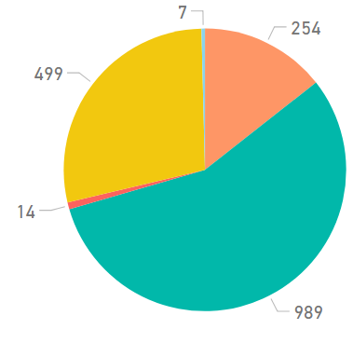
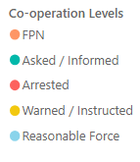
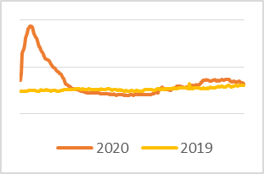
Service Centre Demand
Crime
Crime Volume (9 March – Present compared to Previous Year)
Crime has continued to trend at levels lower than the seasonal average, and total crime volume year to date continues to remain lower (6%) than last year.
7486 Offences under COVID Legislation
Recorded COVID Charges are pulled from Police Scotland CRIME systems rather than CVI. Enforcement activity includes Fixed Penalty Notices and offences recorded on Police Scotland’s Crime Recording System
Coronavirus Legislation
The volume of 101 and 999 calls answered showed consistent levels for most of the week however 101 calls show a reduction between 28th -29th Nov.
Crime Volume (9 March – Present compared to Previous Year)
Co-operation with new Coronavirus Legislation
The below chart is indicative of the co-operation levels experienced by police over the last 7 days. The vast majority of interactions between police and the public continue to be resolved without enforcement.
Crime Group Breakdown Change from previous year
Group 1 | Group 2 | Group 3 | Group 4 | Group 5
-7% | -5% | -16% | -10% | +9%
369893
2019
348148
2020
Incident volume on 28th November 2020 was higher than 2019 levels however remained at a lower level for the remainder of the week. Overall incident volume continues to show lower levels compared to the same time last year.
Incident Demand
Crime Group Breakdown
Change from previous year
Quarantine Referrals to 29th November
Public Health Scotland Travel Regs. Referrals | 2246
Investigated by Resolution Team | 543
Investigated by Local Policing | 458
Investigations Ongoing | 0
Weeded prior to investigation | 1245
Absence
Gatherings in Private Dwellings
From 28/08/2020 – 29/11/2020
Travel Reg. offences resulting in FPN or SPR | 13
5190 Attended reports of House Party
2847 House Parties Dispersed
Absences throughout the entire week has continued to trend above levels when compared to 2019.
Note: The referral figures are a count of reports submitted to Police Scotland. These will therefore vary from counts of the number of individuals.
FPNs may be derived from PHS, Home Office Referrals or from operational incidents.
.
Date of Highest
% Change from dates
No figures should be considered as Official Police Statistics. These may not yet have been verified or validated.
OFFICIAL

Slide 3

Weekly Service Centre Demand (26th – 2nd December 2020)
 | 26-Nov | 27-Nov | 28-Nov | 29-Nov | 30-Nov | 01-Dec | 02-Dec | Total
2020 101 Ans | 3857 | 3949 | 3848 | 3167 | 3755 | 3933 | 3847 | 26,356
2020 999 Ans | 1330 | 1647 | 1790 | 1552 | 1367 | 1456 | 1421 | 10,563
2019 101 Ans | 4,392 | 4,461 | 3,859 | 3,916 | 3,442 | 3,459 | 4,395 | 27,924
2019 999 Ans | 1457 | 1534 | 1670 | 2038 | 2079 | 1932 | 1454 | 12,164
No figures should be considered as Official Police Statistics. These may not yet have been verified or validated.

Slide 4
Cumulative Service Centre Demand (19th March – 2nd December 2020)
Total | Total |  |  |  |  |  |  |  |  |  |  |  |  |  |  |  | March |  | 19-Mar | 20-Mar | 21-Mar | 22-Mar | 23-Mar | 24-Mar | 25-Mar | 26-Mar | 27-Mar | 28-Mar | 29-Mar | 30-Mar | 31-Mar
2020 101 Ans | 1056423 |  |  |  |  |  |  |  |  |  |  |  |  |  |  |  | 2020 101 Ans |  | 3029 | 3362 | 3484 | 2852 | 4196 | 4755 | 4499 | 4510 | 4784 | 4169 | 3115 | 4977 | 4866
2020 999 Ans | 437952 |  |  |  |  |  |  |  |  |  |  |  |  |  |  |  | 2020 999 Ans |  | 1904 | 2038 | 1929 | 1558 | 1311 | 1447 | 1336 | 1299 | 1471 | 1391 | 1302 | 1314 | 1259
April | 01-Apr | 02-Apr | 03-Apr | 04-Apr | 05-Apr | 06-Apr | 07-Apr | 08-Apr | 09-Apr | 10-Apr | 11-Apr | 12-Apr | 13-Apr | 14-Apr | 15-Apr | 16-Apr | 17-Apr | 18-Apr | 19-Apr | 20-Apr | 21-Apr | 22-Apr | 23-Apr | 24-Apr | 25-Apr | 26-Apr | 27-Apr | 28-Apr | 29-Apr | 30-Apr
2020 101 Ans | 4579 | 4550 | 4506 | 3753 | 3618 | 4935 | 4873 | 4663 | 4332 | 4954 | 4654 | 4394 | 4881 | 4846 | 4780 | 4861 | 4793 | 4874 | 4303 | 4856 | 4647 | 4728 | 4530 | 4910 | 5101 | 4311 | 4739 | 4647 | 4295 | 4494
2020 999 Ans | 1204 | 1145 | 1333 | 1440 | 1355 | 1272 | 1432 | 1312 | 1426 | 1545 | 1739 | 1386 | 1182 | 1232 | 1403 | 1238 | 1391 | 1406 | 1354 | 1248 | 1348 | 1408 | 1353 | 1752 | 1808 | 1231 | 1137 | 1090 | 1106 | 1082
May | 01-May | 02-May | 03-May | 04-May | 05-May | 06-May | 07-May | 08-May | 09-May | 10-May | 11-May | 12-May | 13-May | 14-May | 15-May | 16-May | 17-May | 18-May | 19-May | 20-May | 21-May | 22-May | 23-May | 24-May | 25-May | 26-May | 27-May | 28-May | 29-May | 30-May | 31-May
2020 101 Ans | 4884 | 5017 | 4069 | 4630 | 4340 | 4751 | 4665 | 5008 | 4865 | 3974 | 4764 | 4701 | 5205 | 4668 | 5080 | 4412 | 3898 | 4754 | 4576 | 4302 | 4235 | 4652 | 4131 | 3911 | 4600 | 4629 | 4563 | 4264 | 4260 | 3935 | 3626
2020 999 Ans | 1369 | 1509 | 1353 | 1257 | 1461 | 1761 | 1644 | 1670 | 1666 | 1240 | 1257 | 1135 | 1244 | 1344 | 1322 | 1510 | 1271 | 1295 | 1407 | 2185 | 1831 | 1500 | 1278 | 1325 | 1467 | 1613 | 1702 | 1961 | 2741 | 2936 | 2342
June | 01-Jun | 02-Jun | 03-Jun | 04-Jun | 05-Jun | 06-Jun | 07-Jun | 08-Jun | 09-Jun | 10-Jun | 11-Jun | 12-Jun | 13-Jun | 14-Jun | 15-Jun | 16-Jun | 17-Jun | 18-Jun | 19-Jun | 20-Jun | 21-Jun | 22-Jun | 23-Jun | 24-Jun | 25-Jun | 26-Jun | 27-Jun | 28-Jun | 29-Jun | 30-Jun
2020 101 Ans | 4086 | 4376 | 4403 | 4289 | 4657 | 4411 | 3899 | 4568 | 4029 | 4315 | 4896 | 4974 | 4443 | 4086 | 4608 | 4947 | 5045 | 4538 | 4139 | 4441 | 3994 | 4691 | 4877 | 5084 | 4316 | 4677 | 4831 | 4033 | 4706 | 4569
2020 999 Ans | 2356 | 1791 | 1465 | 1470 | 1448 | 1819 | 1690 | 1637 | 1467 | 1070 | 1452 | 1629 | 1757 | 1902 | 1564 | 1646 | 1628 | 1805 | 2041 | 2493 | 1786 | 1321 | 1429 | 1720 | 2392 | 2085 | 2010 | 1593 | 1332 | 1518
July | 01-Jul | 02-Jul | 03-Jul | 04-Jul | 05-Jul | 06-Jul | 07-Jul | 08-Jul | 09-Jul | 10-Jul | 11-Jul | 12-Jul | 13-Jul | 14-Jul | 15-Jul | 16-Jul | 17-Jul | 18-Jul | 19-Jul | 20-Jul | 21-Jul | 22-Jul | 23-Jul | 24-Jul | 25-Jul | 26-Jul | 27-Jul | 28-Jul | 29-Jul | 30-Jul | 31-Jul
2020 101 Ans | 4357 | 4642 | 4623 | 4769 | 3902 | 4570 | 4099 | 4073 | 4323 | 4099 | 4313 | 3852 | 4237 | 3768 | 4000 | 4136 | 3941 | 3376 | 3242 | 4169 | 3879 | 3954 | 3971 | 4121 | 4013 | 3085 | 4384 | 3658 | 4309 | 3788 | 3760
2020 999 Ans | 1371 | 1502 | 1651 | 1764 | 1499 | 1662 | 1952 | 1666 | 1502 | 1907 | 2338 | 2128 | 1656 | 1631 | 1680 | 1856 | 2039 | 2696 | 2225 | 1751 | 1784 | 1613 | 1694 | 2064 | 2274 | 2434 | 1465 | 1860 | 1662 | 1664 | 2429
August | 01-Aug | 02-Aug | 03-Aug | 04-Aug | 05-Aug | 06-Aug | 07-Aug | 08-Aug | 09-Aug | 10-Aug | 11-Aug | 12-Aug | 13-Aug | 14-Aug | 15-Aug | 16-Aug | 17-Aug | 18-Aug | 19-Aug | 20-Aug | 21-Aug | 22-Aug | 23-Aug | 24-Aug | 25-Aug | 26-Aug | 27-Aug | 28-Aug | 29-Aug | 30-Aug | 31-Aug
2020 101 Ans | 2725 | 3005 | 3778 | 3637 | 4217 | 3821 | 3560 | 3656 | 3432 | 4204 | 4202 | 4428 | 3640 | 3996 | 3944 | 3508 | 4231 | 3921 | 3729 | 4074 | 4242 | 3524 | 3210 | 4130 | 4005 | 3461 | 3670 | 3722 | 3162 | 3291 | 3953
2020 999 Ans | 3060 | 2447 | 1922 | 1722 | 1516 | 2002 | 2423 | 2862 | 2641 | 1894 | 1899 | 2361 | 2280 | 2491 | 2814 | 2233 | 1654 | 1704 | 1903 | 1737 | 1959 | 2612 | 2151 | 1785 | 1491 | 1484 | 1552 | 1843 | 2360 | 2107 | 1476
September | 01-Sep | 02-Sep | 03-Sep | 04-Sep | 05-Sep | 06-Sep | 07-Sep | 08-Sep | 09-Sep | 10-Sep | 11-Sep | 12-Sep | 13-Sep | 14-Sep | 15-Sep | 16-Sep | 17-Sep | 18-Sep | 19-Sep | 20-Sep | 21-Sep | 22-Sep | 23-Sep | 24-Sep | 25-Sep | 26-Sep | 27-Sep | 28-Sep | 29-Sep | 30-Sep
2020 101 Ans | 4117 | 3859 | 3763 | 3472 | 2921 | 2879 | 3579 | 4154 | 3883 | 3555 | 3419 | 3456 | 3335 | 3528 | 3506 | 3690 | 3515 | 3641 | 4134 | 3473 | 4182 | 3998 | 4198 | 4266 | 4071 | 4087 | 4065 | 4029 | 3622 | 4277
2020 999 Ans | 1414 | 1461 | 1527 | 2016 | 2317 | 2241 | 1701 | 1527 | 1634 | 1555 | 1923 | 1946 | 1937 | 1820 | 1919 | 1746 | 1826 | 2277 | 2353 | 1976 | 1627 | 1448 | 1496 | 1399 | 1783 | 2012 | 1569 | 1396 | 1628 | 1368
October | 01-Oct | 02-Oct | 03-Oct | 04-Oct | 05-Oct | 06-Oct | 07-Oct | 08-Oct | 09-Oct | 10-Oct | 11-Oct | 12-Oct | 13-Oct | 14-Oct | 15-Oct | 16-Oct | 17-Oct | 18-Oct | 19-Oct | 20-Oct | 21-Oct | 22-Oct | 23-Oct | 24-Oct | 25-Oct | 26-Oct | 27-Oct | 28-Oct | 29-Oct | 30-Oct | 31-Oct
2020 101 Ans | 3644 | 3815 | 4209 | 3706 | 4281 | 4160 | 3875 | 3256 | 3659 | 3634 | 2962 | 3553 | 3790 | 3480 | 3295 | 2820 | 3185 | 3012 | 3634 | 3577 | 3958 | 3787 | 4151 | 4215 | 3839 | 4019 | 3271 | 3569 | 3759 | 4101 | 3512
2020 999 Ans | 1500 | 2094 | 1727 | 1673 | 1606 | 1523 | 1484 | 1628 | 1831 | 2066 | 1817 | 1487 | 1547 | 1632 | 1672 | 2138 | 2531 | 2017 | 1473 | 1467 | 1536 | 1559 | 1733 | 1731 | 1491 | 1399 | 1314 | 1427 | 1398 | 1845 | 2317
November | 01-Nov | 02-Nov | 03-Nov | 04-Nov | 05-Nov | 06-Nov | 07-Nov | 08-Nov | 09-Nov | 10-Nov | 11-Nov | 12-Nov | 13-Nov | 14-Nov | 15-Nov | 16-Nov | 17-Nov | 18-Nov | 19-Nov | 20-Nov | 21-Nov | 22-Nov | 23-Nov | 24-Nov | 25-Nov | 26-Nov | 27-Nov | 28-Nov | 29-Nov | 30-Nov
2020 101 Ans | 3592 | 3734 | 3670 | 4043 | 3411 | 3934 | 4120 | 3475 | 4607 | 4308 | 4156 | 3671 | 3908 | 3959 | 3574 | 3852 | 3628 | 3783 | 3783 | 4147 | 4326 | 3702 | 3858 | 3528 | 4103 | 3857 | 3949 | 3848 | 3167 | 3755
2020 999 Ans | 1659 | 1592 | 1460 | 1606 | 2414 | 2096 | 1793 | 1444 | 1384 | 1314 | 1296 | 1512 | 1879 | 1745 | 1563 | 1505 | 1240 | 1457 | 1549 | 1690 | 1636 | 1314 | 1273 | 1380 | 1450 | 1330 | 1647 | 1790 | 1552 | 1367
December | 01-Dec | 02-Dec
2020 101 Ans | 3933 | 3847
2020 999 Ans | 1456 | 1421
No figures should be considered as Official Police Statistics. These may not yet have been verified or validated.

Slide 5
Weekly Incident Demand (26th November – 2nd December 2020)
 | 26-Nov | 27-Nov | 28-Nov | 29-Nov | 30-Nov | 01-Dec | 02-Dec | Total
2020 | 3786 | 4267 | 4345 | 3615 | 3719 | 3887 | 3666 | 27285
2019 | 3984 | 4279 | 3984 | 4607 | 4438 | 4115 | 3958 | 29365
No figures should be considered as Official Police Statistics. These may not yet have been verified or validated.

Slide 6
Cumulative Incident Demand (19th March – 2nd December 2020)
Incident Volumes by date – 2019 vs 2020
Total | Total |  |  |  |  |  |  |  |  |  |  |  |  |  |  |  |  | March | 19-Mar | 20-Mar | 21-Mar | 22-Mar | 23-Mar | 24-Mar | 25-Mar | 26-Mar | 27-Mar | 28-Mar | 29-Mar | 30-Mar | 31-Mar
2020 | 1104825 |  |  |  |  |  |  |  |  |  |  |  |  |  |  |  |  | 2020 | 3752 | 4293 | 4117 | 3455 | 3443 | 3207 | 3659 | 3631 | 4023 | 3819 | 3169 | 4109 | 4014
2019 | 1239304 |  |  |  |  |  |  |  |  |  |  |  |  |  |  |  |  | 2019 | 4549 | 4606 | 4618 | 5217 | 5082 | 4351 | 4695 | 4507 | 4564 | 4544 | 5270 | 5176 | 5152
April | 01-Apr | 02-Apr | 03-Apr | 04-Apr | 05-Apr | 06-Apr | 07-Apr | 08-Apr | 09-Apr | 10-Apr | 11-Apr | 12-Apr | 13-Apr | 14-Apr | 15-Apr | 16-Apr | 17-Apr | 18-Apr | 19-Apr | 20-Apr | 21-Apr | 22-Apr | 23-Apr | 24-Apr | 25-Apr | 26-Apr | 27-Apr | 28-Apr | 29-Apr | 30-Apr
2020 | 3837 | 3806 | 4130 | 3874 | 3666 | 4242 | 4458 | 4298 | 4117 | 4844 | 4974 | 4319 | 4408 | 4277 | 4462 | 4276 | 4444 | 4771 | 4296 | 4312 | 4258 | 4395 | 4296 | 5067 | 5366 | 4150 | 4042 | 3937 | 3719 | 3738
2019 | 4482 | 4368 | 4209 | 4436 | 5134 | 4738 | 4321 | 4668 | 4676 | 4818 | 4863 | 5202 | 5340 | 4457 | 4651 | 4470 | 4668 | 5079 | 6157 | 6080 | 5611 | 5292 | 5004 | 4617 | 4622 | 5063 | 5002 | 4701 | 4915 | 4747
May | 01-May | 02-May | 03-May | 04-May | 05-May | 06-May | 07-May | 08-May | 09-May | 10-May | 11-May | 12-May | 13-May | 14-May | 15-May | 16-May | 17-May | 18-May | 19-May | 20-May | 21-May | 22-May | 23-May | 24-May | 25-May | 26-May | 27-May | 28-May | 29-May | 30-May | 31-May
2020 | 4568 | 4932 | 4056 | 4042 | 4324 | 5033 | 4631 | 5122 | 4986 | 3746 | 4155 | 3995 | 4363 | 4164 | 4492 | 4458 | 3697 | 4104 | 4237 | 4814 | 4447 | 4360 | 3854 | 3927 | 4350 | 4481 | 4613 | 4787 | 5520 | 5547 | 4706
2019 | 4921 | 4539 | 4896 | 5130 | 4749 | 4458 | 4474 | 4144 | 4516 | 5012 | 5361 | 5445 | 5189 | 4946 | 5213 | 5083 | 5637 | 5037 | 4707 | 4701 | 4851 | 4647 | 4873 | 5420 | 5236 | 4957 | 4559 | 4708 | 4482 | 4473 | 5074
June | 01-Jun | 02-Jun | 03-Jun | 04-Jun | 05-Jun | 06-Jun | 07-Jun | 08-Jun | 09-Jun | 10-Jun | 11-Jun | 12-Jun | 13-Jun | 14-Jun | 15-Jun | 16-Jun | 17-Jun | 18-Jun | 19-Jun | 20-Jun | 21-Jun | 22-Jun | 23-Jun | 24-Jun | 25-Jun | 26-Jun | 27-Jun | 28-Jun | 29-Jun | 30-Jun
2020 | 4854 | 4383 | 4197 | 4021 | 4321 | 4747 | 4130 | 4377 | 3922 | 3658 | 4421 | 4754 | 4599 | 4651 | 4311 | 4593 | 4632 | 4542 | 4540 | 5462 | 4252 | 4057 | 4232 | 4849 | 5182 | 5094 | 5051 | 4058 | 3936 | 4345
2019 | 5632 | 5002 | 4626 | 4689 | 4469 | 4882 | 5515 | 5233 | 4847 | 5051 | 4801 | 4464 | 4312 | 5186 | 5438 | 4746 | 4759 | 4603 | 4895 | 4650 | 5317 | 5594 | 4766 | 4647 | 4690 | 5180 | 5071 | 5889 | 5759 | 4996
July | 01-Jul | 02-Jul | 03-Jul | 04-Jul | 05-Jul | 06-Jul | 07-Jul | 08-Jul | 09-Jul | 10-Jul | 11-Jul | 12-Jul | 13-Jul | 14-Jul | 15-Jul | 16-Jul | 17-Jul | 18-Jul | 19-Jul | 20-Jul | 21-Jul | 22-Jul | 23-Jul | 24-Jul | 25-Jul | 26-Jul | 27-Jul | 28-Jul | 29-Jul | 30-Jul | 31-Jul
2020 | 3924 | 4388 | 4430 | 4765 | 3956 | 4557 | 4228 | 4148 | 4148 | 4464 | 5082 | 4537 | 4174 | 3895 | 3995 | 4292 | 4509 | 4815 | 4197 | 4225 | 4192 | 3985 | 4041 | 4706 | 4904 | 4276 | 3937 | 3948 | 4240 | 3915 | 5005
2019 | 4918 | 4618 | 4819 | 4668 | 4995 | 5388 | 4988 | 4980 | 4432 | 4831 | 4877 | 5511 | 5565 | 5067 | 5332 | 5061 | 4581 | 4801 | 5032 | 5076 | 4591 | 4922 | 5203 | 5235 | 5489 | 5853 | 5519 | 5368 | 5052 | 4979 | 4902
August | 01-Aug | 02-Aug | 03-Aug | 04-Aug | 05-Aug | 06-Aug | 07-Aug | 08-Aug | 09-Aug | 10-Aug | 11-Aug | 12-Aug | 13-Aug | 14-Aug | 15-Aug | 16-Aug | 17-Aug | 18-Aug | 19-Aug | 20-Aug | 21-Aug | 22-Aug | 23-Aug | 24-Aug | 25-Aug | 26-Aug | 27-Aug | 28-Aug | 29-Aug | 30-Aug | 31-Aug
2020 | 4804 | 4342 | 4167 | 3934 | 4019 | 4388 | 4630 | 5412 | 4783 | 4344 | 4417 | 5099 | 4554 | 5087 | 5331 | 4348 | 4091 | 4171 | 4258 | 4382 | 4848 | 5127 | 4264 | 4244 | 3888 | 3858 | 3958 | 4347 | 4677 | 4246 | 4059
2019 | 4917 | 5761 | 5847 | 5195 | 4855 | 4674 | 4946 | 5020 | 5314 | 5673 | 4774 | 4872 | 4490 | 4505 | 4812 | 5165 | 5245 | 4660 | 4748 | 4590 | 4428 | 4507 | 5350 | 5821 | 5265 | 4712 | 4542 | 4692 | 4541 | 4998 | 5281
September | 01-Sep | 02-Sep | 03-Sep | 04-Sep | 05-Sep | 06-Sep | 07-Sep | 08-Sep | 09-Sep | 10-Sep | 11-Sep | 12-Sep | 13-Sep | 14-Sep | 15-Sep | 16-Sep | 17-Sep | 18-Sep | 19-Sep | 20-Sep | 21-Sep | 22-Sep | 23-Sep | 24-Sep | 25-Sep | 26-Sep | 27-Sep | 28-Sep | 29-Sep | 30-Sep
2020 | 4055 | 3766 | 3877 | 4451 | 4505 | 4135 | 4029 | 4123 | 4125 | 3959 | 4287 | 4450 | 4139 | 4076 | 4194 | 4202 | 4211 | 4868 | 5180 | 4253 | 4235 | 3871 | 4172 | 4027 | 4573 | 4792 | 4183 | 3937 | 4023 | 3942
2019 | 5235 | 4408 | 4189 | 4177 | 4381 | 4858 | 5054 | 4626 | 4385 | 4232 | 4352 | 4424 | 4880 | 4984 | 4532 | 4475 | 4516 | 4709 | 4556 | 5200 | 5440 | 4422 | 4702 | 4509 | 4352 | 4367 | 4805 | 5319 | 4717 | 4625
October | 01-Oct | 02-Oct | 03-Oct | 04-Oct | 05-Oct | 06-Oct | 07-Oct | 08-Oct | 09-Oct | 10-Oct | 11-Oct | 12-Oct | 13-Oct | 14-Oct | 15-Oct | 16-Oct | 17-Oct | 18-Oct | 19-Oct | 20-Oct | 21-Oct | 22-Oct | 23-Oct | 24-Oct | 25-Oct | 26-Oct | 27-Oct | 28-Oct | 29-Oct | 30-Oct | 31-Oct
2020 | 3921 | 4555 | 4363 | 4097 | 4180 | 4138 | 3953 | 3815 | 4396 | 4543 | 3939 | 3711 | 3889 | 3802 | 3942 | 4126 | 5004 | 3948 | 3717 | 3826 | 4145 | 3991 | 4473 | 4549 | 3994 | 4018 | 3520 | 3871 | 3692 | 4611 | 4898
2019 | 4191 | 4392 | 4020 | 4670 | 4728 | 4125 | 4362 | 4193 | 4344 | 4454 | 5111 | 5030 | 4325 | 4702 | 4475 | 4495 | 4420 | 4846 | 4947 | 4566 | 4548 | 4185 | 4443 | 4298 | 4845 | 4631 | 4622 | 4435 | 4230 | 4225 | 4821
November | 01-Nov | 02-Nov | 03-Nov | 04-Nov | 05-Nov | 06-Nov | 07-Nov | 08-Nov | 09-Nov | 10-Nov | 11-Nov | 12-Nov | 13-Nov | 14-Nov | 15-Nov | 16-Nov | 17-Nov | 18-Nov | 19-Nov | 20-Nov | 21-Nov | 22-Nov | 23-Nov | 24-Nov | 25-Nov | 26-Nov | 27-Nov | 28-Nov | 29-Nov | 30-Nov
2020 | 4067 | 3916 | 3829 | 4096 | 4716 | 4762 | 4658 | 3718 | 4111 | 4000 | 3774 | 3889 | 4523 | 4427 | 3849 | 3847 | 3813 | 3773 | 3828 | 4426 | 4359 | 3563 | 3629 | 3613 | 3980 | 3786 | 4267 | 4345 | 3615 | 3719
2019 | 4893 | 4796 | 4521 | 4548 | 5246 | 4461 | 4219 | 4785 | 4729 | 4207 | 4207 | 4125 | 4256 | 4203 | 4561 | 4615 | 4072 | 4123 | 3980 | 3956 | 4224 | 4499 | 4577 | 4113 | 4191 | 3984 | 4279 | 3984 | 4607 | 4438
December | 01-Dec | 02-Dec
2020 | 3887 | 3666
2019 | 4115 | 3958
Note: No figures should be considered as Official Police Statistics. These may not yet have been verified or validated.

Slide 7
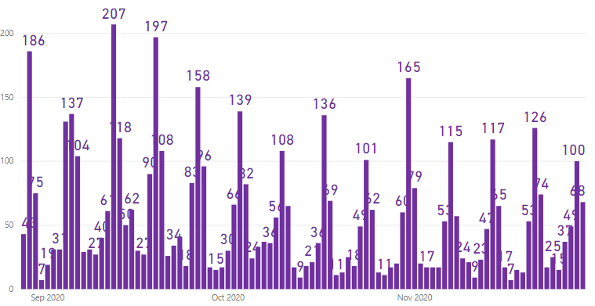
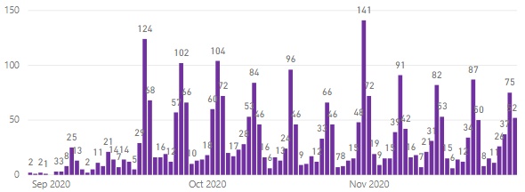
Incident Demand – House Gatherings (28th August – 29th November 2020)
From Friday 28th August 2020, additional monitoring of ‘house gatherings’ incidents has taken place. This will be reported weekly going forward.
Attended ‘House Gatherings’ Incidents
Attended ‘House Gatherings’ Breaching Restrictions
Totals | 28 Aug – 29 Nov | 23 Nov – 29 Nov
No. of House Gatherings Attended | 5190 | 311
No. of House Gatherings Breaching Restrictions | 2847 | 224
No. of FPNs issued | 2312 | 235
No. of Arrests | 303 | 24
The figures contained within this slide originate from storm incident reviews and free-text local policing returns to provide the most comprehensive view of house gatherings possible.
Note: No figures should be considered as Official Police Statistics. These may not yet have been verified or validated.

Slide 8
Weekly Crime Demand (23rd – 29th November 2020)
Crime Group | 1 | 2 | 3 | 4 | 5 | 6 | 7 | Total
2019/20 | 170 | 348 | 2032 | 812 | 1147 | 2444 | 2186 | 9139
2020/21 | 147 | 242 | 1876 | 852 | 1352 | 2121 | 1711 | 8301
All Crime Groups show a decrease in volume when the preceding weeks volume is compared to the same period in 2019 with the exception of Group 4 and 5 crimes.
The majority of divisions this week have noted a decrease in crime volumes, however, North East, Lothians & Scottish Borders and Fife show an increase.
More information regarding Crime Groups can be found via this link
No figures should be considered as Official Police Statistics. These may not yet have been verified or validated.

Slide 9
Cumulative Crime Demand (16th March – 29th November 2020)
Crime Group | 1 | 2 | 3 | 4 | 5 | 6 | 7 | Total
2019/20 | 6999 | 10118 | 82143 | 35683 | 48669 | 97092 | 89189 | 369893
2020/21 | 6496 | 9603 | 68728 | 31988 | 53228 | 95198 | 82907 | 348148
All Crime Groups (with the exception of Group 5) show a decrease in volume when compared to the same period in 2019.
All Divisions continue to show a cumulative decrease in volume when compared to the same time period in 2019.
More information regarding Crime Groups can be found via this link
No figures should be considered as Official Police Statistics. These may not yet have been verified or validated.

Slide 10
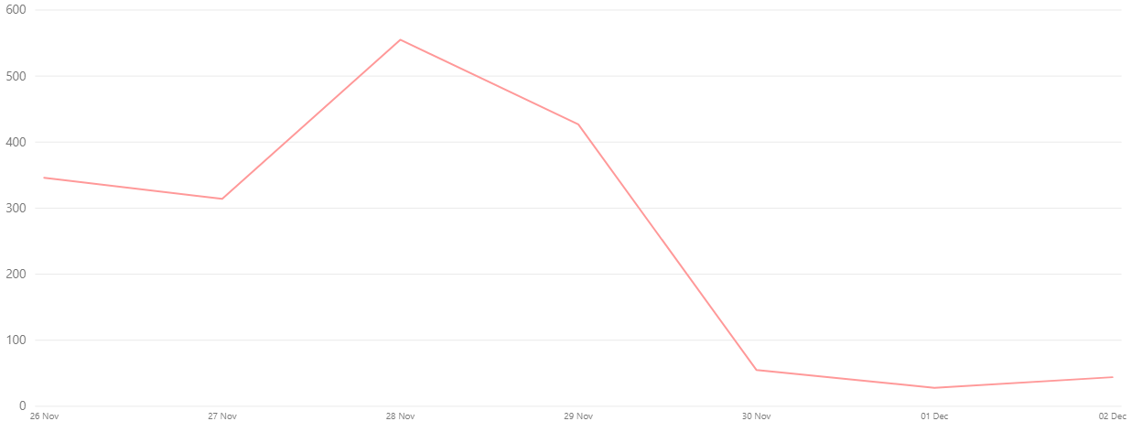
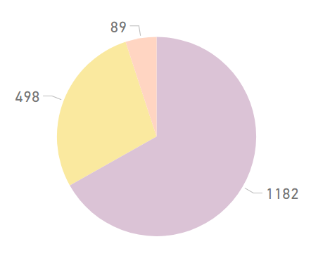
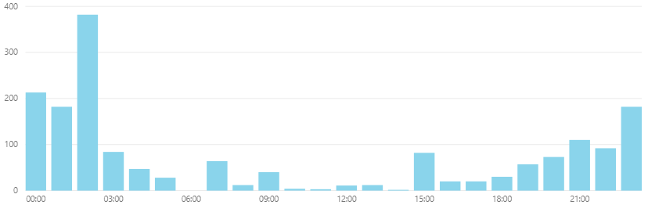
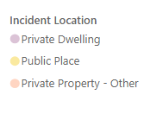
Weekly Legislation Co-operation (26th November – 2nd December 2020)
Weekly Cooperation Levels
Interaction Totals (Preceding Week)
An ‘interaction’ is any instance where a Police Officer has reason to engage with a person who is not conforming with Legislation. Only when all efforts to encourage co-operation fail will Police Officers resort to enforcement.
Weekly Intervention Locations
Interaction Times (Preceding Week)
In response to the introduction of The Health Protection (Coronavirus) (Restrictions) (Scotland) Regulations 2020 and Coronavirus Act 2020, Police Scotland developed a ‘Coronavirus Interventions’ (CVI) recording system. This system allowed Police Scotland to begin gathering data in relation to the public co-operation levels with the new legislation. This system relies on Police Officers manually updating the system with the co-operation level when they encounter an individual in contravention of the new legislation. This slide includes all offence types – Face-Coverings, Quarantine, Travel Restrictions and Gatherings.
Due to the manual input required to form this data set, the contents of this slide are indicative only. Actual figures will differ from those recorded on Crime Systems (please see slide 11), may be subject to change, and cannot be considered Official Police Statistics. They do provide an indication of the public co-operation levels across Scotland.
No figures should be considered as Official Police Statistics. These may not yet have been verified or validated.

Slide 11
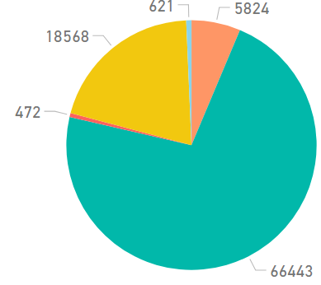
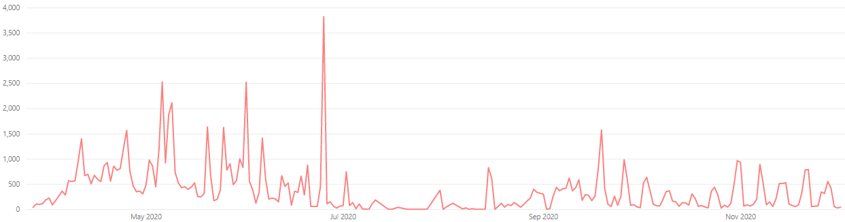
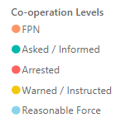
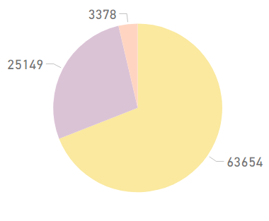
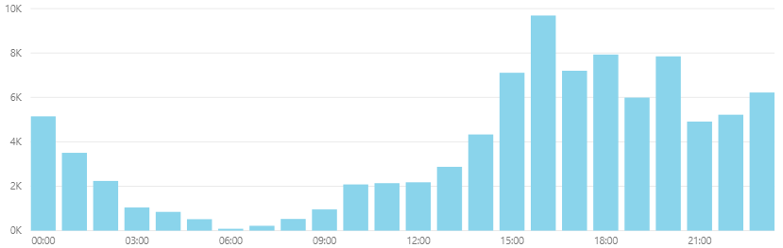
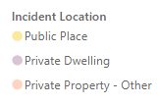
Coronavirus Legislation Co-operation (27th March – 2nd December 2020)
All Time Cooperation Levels
Interaction Totals (All Time)
An ‘interaction’ is any instance where a Police Officer has reason to engage with a person who is not conforming with Legislation. Only when all efforts to encourage co-operation fail will Police Officers resort to enforcement.
All Time Intervention Locations
Interaction Times (All Time)
In response to the introduction of The Health Protection (Coronavirus) (Restrictions) (Scotland) Regulations 2020 and Coronavirus Act 2020, Police Scotland developed a ‘Coronavirus Interventions’ (CVI) recording system. This system allowed Police Scotland to begin gathering data in relation to the public co-operation levels with the new legislation. This system relies on Police Officers manually updating the system with the co-operation level when they encounter an individual in contravention of the new legislation. This slide includes all offence types – Face-Coverings, Quarantine, Travel Restrictions and Gatherings.
Due to the manual input required to form this data set, the contents of this slide are indicative only. Actual figures will differ from those recorded on Crime Systems (please see slide 11), may be subject to change, and cannot be considered Official Police Statistics. They do provide an indication of the public co-operation levels across Scotland.
No figures should be considered as Official Police Statistics. These may not yet have been verified or validated.

Slide 12
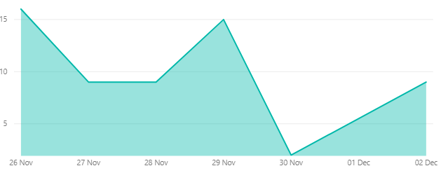
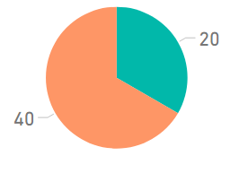
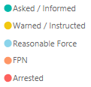
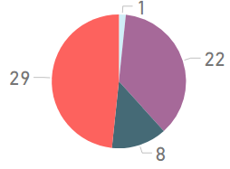
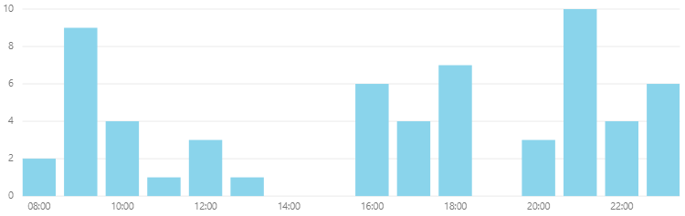

Weekly Travel Regulation Co-operation (26th November – 2nd December 2020)
Weekly Cooperation Levels
CVI Activity by Date
An ‘interaction’ is any instance where a Police Officer has reason to engage with a person who is not conforming with Legislation. Only when all efforts to encourage co-operation fail will Police Officers resort to enforcement.
Weekly Intervention by Tier
CVI Interaction Times
In order to report upon policing interventions in respect of the newly introduced Travel Regulations regarding travel to or from tiers 3 and 4, the CVI system has been updated. The above data is a sub-set of the wider CVI interventions reported on the previous slides and should not be considered as ‘in addition to’ the previous overall CVI activity slides.
In response to the introduction of The Health Protection (Coronavirus) (Restrictions) (Scotland) Regulations 2020 and Coronavirus Act 2020, Police Scotland developed a ‘Coronavirus Interventions’ (CVI) recording system. This system allowed Police Scotland to begin gathering data in relation to the public co-operation levels with the new legislation. This system relies on Police Officers manually updating the system with the co-operation level when they encounter an individual in contravention of the new legislation.
Due to the manual input required to form this data set, the contents of this slide are indicative only. Actual figures will differ from those recorded on Crime Systems (please see slide 11), may be subject to change, and cannot be considered Official Police Statistics. They do provide an indication of the public co-operation levels across Scotland.
No figures should be considered as Official Police Statistics. These may not yet have been verified or validated.

Slide 13
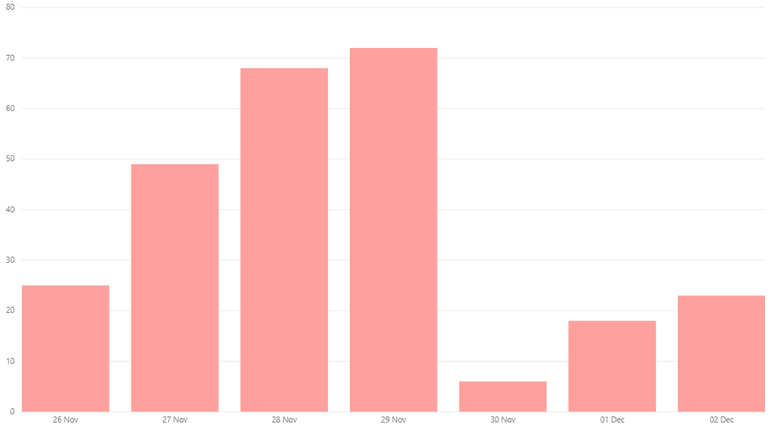
‘Enforcement’ of Coronavirus specific legislation
OFFICIAL
The following is a summary of all ‘enforcement’ action in relation to both The Health Protection (Coronavirus) (Restrictions) (Scotland) Regulations 2020 and Coronavirus Act 2020.
This includes all Fixed Penalty Notices issued and processed by Police Scotland. It also includes all occasions that a charge was libelled and recorded on Police Scotland’s Crime Recording System against a person in relation to the aforementioned legislation. This is a true value of the volume of recorded ‘enforcement’ activity, but does not provide the granularity of the Coronavirus Intervention (CVI) recording system and does not capture the earlier phases of the ‘4 E’s’ approach.
These values remain subject to change as offences are retrospectively added or amended and do not match the indicative ‘enforcement’ values from the CVI recording system.
Volume of Covid-19 Charges from 26th November to 2nd December 2020
Charges over the last 7 days | 261
Total Charges To Date | 7486
No figures should be considered as Official Police Statistics. These may not yet have been verified or validated.

Slide 14
‘Enforcement’ of Coronavirus specific legislation
OFFICIAL
The following is a summary of all ‘enforcement’ action in relation to both The Health Protection (Coronavirus) (Restrictions) (Scotland) Regulations 2020 and Coronavirus Act 2020.
This includes all Fixed Penalty Notices issued and processed by Police Scotland. It also includes all occasions that a charge was libelled and recorded on Police Scotland’s Crime Recording System against a person in relation to the aforementioned legislation. This is a true value of the volume of recorded ‘enforcement’ activity, but does not provide the granularity of the Coronavirus Intervention (CVI) recording system and does not capture the earlier phases of the ‘4 E’s’ approach.
These values remain subject to change as offences are retrospectively added or amended and do not match the indicative ‘enforcement’ values from the CVI recording system.
Volume of Covid-19 Charges by Date
Total | Total |  |  |  |  |  |  |  |  |  |  |  |  |  |  |  |  |  |  |  |  |  |  |  |  | March | 27-Mar | 28-Mar | 29-Mar | 30-Mar | 31-Mar
2020 | 7486 |  |  |  |  |  |  |  |  |  |  |  |  |  |  |  |  |  |  |  |  |  |  |  |  | 2020 | 5 | 17 | 16 | 27 | 45
April | 01-Apr | 02-Apr | 03-Apr | 04-Apr | 05-Apr | 06-Apr | 07-Apr | 08-Apr | 09-Apr | 10-Apr | 11-Apr | 12-Apr | 13-Apr | 14-Apr | 15-Apr | 16-Apr | 17-Apr | 18-Apr | 19-Apr | 20-Apr | 21-Apr | 22-Apr | 23-Apr | 24-Apr | 25-Apr | 26-Apr | 27-Apr | 28-Apr | 29-Apr | 30-Apr
2020 | 44 | 20 | 29 | 83 | 89 | 71 | 97 | 81 | 139 | 180 | 162 | 140 | 151 | 110 | 130 | 109 | 100 | 115 | 87 | 63 | 99 | 123 | 81 | 87 | 141 | 63 | 50 | 67 | 72 | 71
May | 01-May | 02-May | 03-May | 04-May | 05-May | 06-May | 07-May | 08-May | 09-May | 10-May | 11-May | 12-May | 13-May | 14-May | 15-May | 16-May | 17-May | 18-May | 19-May | 20-May | 21-May | 22-May | 23-May | 24-May | 25-May | 26-May | 27-May | 28-May | 29-May | 30-May | 31-May
2020 | 96 | 90 | 73 | 52 | 113 | 123 | 102 | 117 | 113 | 66 | 35 | 33 | 47 | 57 | 50 | 64 | 44 | 23 | 32 | 40 | 41 | 38 | 31 | 71 | 52 | 31 | 34 | 24 | 11 | 8 | 11
June | 01-Jun | 02-Jun | 03-Jun | 04-Jun | 05-Jun | 06-Jun | 07-Jun | 08-Jun | 09-Jun | 10-Jun | 11-Jun | 12-Jun | 13-Jun | 14-Jun | 15-Jun | 16-Jun | 17-Jun | 18-Jun | 19-Jun | 20-Jun | 21-Jun | 22-Jun | 23-Jun | 24-Jun | 25-Jun | 26-Jun | 27-Jun | 28-Jun | 29-Jun | 30-Jun
2020 | 16 | 18 | 28 | 9 | 9 | 7 | 20 | 10 | 3 | 4 | 2 | 2 | 13 | 11 | 4 | 6 | 3 | 9 | 3 | 2 | 20 | 2 | 5 | 1 | 5 | 3 | 5 | 3 | 0 | 0
July | 01-Jul | 02-Jul | 03-Jul | 04-Jul | 05-Jul | 06-Jul | 07-Jul | 08-Jul | 09-Jul | 10-Jul | 11-Jul | 12-Jul | 13-Jul | 14-Jul | 15-Jul | 16-Jul | 17-Jul | 18-Jul | 19-Jul | 20-Jul | 21-Jul | 22-Jul | 23-Jul | 24-Jul | 25-Jul | 26-Jul | 27-Jul | 28-Jul | 29-Jul | 30-Jul | 31-Jul
2020 | 0 | 3 | 0 | 6 | 1 | 2 | 3 | 0 | 0 | 0 | 2 | 1 | 3 | 0 | 0 | 2 | 0 | 0 | 0 | 0 | 0 | 0 | 0 | 0 | 0 | 1 | 0 | 0 | 0 | 0 | 0
August | 01-Aug | 02-Aug | 03-Aug | 04-Aug | 05-Aug | 06-Aug | 07-Aug | 08-Aug | 09-Aug | 10-Aug | 11-Aug | 12-Aug | 13-Aug | 14-Aug | 15-Aug | 16-Aug | 17-Aug | 18-Aug | 19-Aug | 20-Aug | 21-Aug | 22-Aug | 23-Aug | 24-Aug | 25-Aug | 26-Aug | 27-Aug | 28-Aug | 29-Aug | 30-Aug | 31-Aug
2020 | 1 | 1 | 0 | 0 | 0 | 0 | 2 | 5 | 2 | 0 | 1 | 0 | 0 | 1 | 0 | 3 | 0 | 0 | 0 | 0 | 0 | 1 | 1 | 0 | 0 | 0 | 1 | 0 | 6 | 1 | 0
September | 01-Sep | 02-Sep | 03-Sep | 04-Sep | 05-Sep | 06-Sep | 07-Sep | 08-Sep | 09-Sep | 10-Sep | 11-Sep | 12-Sep | 13-Sep | 14-Sep | 15-Sep | 16-Sep | 17-Sep | 18-Sep | 19-Sep | 20-Sep | 21-Sep | 22-Sep | 23-Sep | 24-Sep | 25-Sep | 26-Sep | 27-Sep | 28-Sep | 29-Sep | 30-Sep
2020 | 0 | 0 | 0 | 18 | 3 | 13 | 4 | 0 | 3 | 1 | 2 | 6 | 2 | 2 | 5 | 7 | 0 | 2 | 7 | 36 | 18 | 0 | 3 | 1 | 6 | 87 | 48 | 1 | 4 | 6
October | 01-Oct | 02-Oct | 03-Oct | 04-Oct | 05-Oct | 06-Oct | 07-Oct | 08-Oct | 09-Oct | 10-Oct | 11-Oct | 12-Oct | 13-Oct | 14-Oct | 15-Oct | 16-Oct | 17-Oct | 18-Oct | 19-Oct | 20-Oct | 21-Oct | 22-Oct | 23-Oct | 24-Oct | 25-Oct | 26-Oct | 27-Oct | 28-Oct | 29-Oct | 30-Oct | 31-Oct
2020 | 2 | 7 | 50 | 66 | 12 | 2 | 5 | 32 | 29 | 32 | 6 | 6 | 3 | 6 | 9 | 7 | 18 | 34 | 3 | 3 | 11 | 12 | 11 | 20 | 32 | 8 | 11 | 6 | 5 | 17 | 90
November | 01-Nov | 02-Nov | 03-Nov | 04-Nov | 05-Nov | 06-Nov | 07-Nov | 08-Nov | 09-Nov | 10-Nov | 11-Nov | 12-Nov | 13-Nov | 14-Nov | 15-Nov | 16-Nov | 17-Nov | 18-Nov | 19-Nov | 20-Nov | 21-Nov | 22-Nov | 23-Nov | 24-Nov | 25-Nov | 26-Nov | 27-Nov | 28-Nov | 29-Nov | 30-Nov
2020 | 196 | 23 | 11 | 22 | 12 | 14 | 155 | 144 | 17 | 13 | 14 | 6 | 31 | 84 | 162 | 20 | 17 | 57 | 44 | 80 | 98 | 151 | 15 | 18 | 22 | 25 | 49 | 68 | 72 | 6
December | 01-Dec | 02-Dec
2020 | 18 | 23
No figures should be considered as Official Police Statistics. These may not yet have been verified or validated.

Slide 15
ABSENCE
Police Scotland Absences (26th November – 2nd December)
2 December 2020 | No. | Change from same day previous week | Change from same day previous week (%)
COVID-19 | 379 | -36 | -9%
Total Absences | 1290 | -83 | -6%
Active Covid-19 Absence Reason
Precautionary Isolation | 137
Symptoms | 21
Tracing | 131
Positive Test | 90
Weekly Absence Levels Line Graph – Comparison of 2019 to 2020
Absences continue to trend above 2019 levels.
Date | 26-Nov | 27-Nov | 28-Nov | 29-Nov | 30-Nov | 01-Dec | 02-Dec
2020 | 1404 | 1396 | 1345 | 1332 | 1320 | 1322 | 1290
2019 | 1211 | 1217 | 1209 | 1229 | 1212 | 1228 | 1206

Slide 16
Total Absence (18th March – 2nd December 2020)
Total Absence Levels Line Graph – Comparison of 2019 to 2020
No figures should be considered as Official Police Statistics. These may not yet have been verified or validated.

Slide 17
Total Absence (18th March – 2nd December 2020)
Total Absence Levels - Comparison of 2019 to 2020
April | 01-Apr | 02-Apr | 03-Apr | 04-Apr | 05-Apr | 06-Apr | 07-Apr | 08-Apr | 09-Apr | 10-Apr | 11-Apr | 12-Apr | 13-Apr | 14-Apr | 15-Apr | 16-Apr | 17-Apr | 18-Apr | 19-Apr | 20-Apr | 21-Apr | 22-Apr | 23-Apr | 24-Apr | 25-Apr | 26-Apr | 27-Apr | 28-Apr | 29-Apr | 30-Apr
2020 | 3562 | 3421 | 3330 | 3258 | 3214 | 3114 | 2992 | 2871 | 2823 | 2730 | 2653 | 2619 | 2548 | 2440 | 2376 | 2347 | 2333 | 2301 | 2292 | 2268 | 2175 | 2105 | 2069 | 2015 | 1981 | 1954 | 1926 | 1870 | 1815 | 1783
2019 | 987 | 995 | 983 | 985 | 976 | 965 | 968 | 978 | 993 | 1022 | 1006 | 1012 | 989 | 989 | 1000 | 1024 | 1024 | 1017 | 1006 | 993 | 988 | 981 | 992 | 988 | 1000 | 1000 | 988 | 984 | 963 | 978
May | 01-May | 02-May | 03-May | 04-May | 05-May | 06-May | 07-May | 08-May | 09-May | 10-May | 11-May | 12-May | 13-May | 14-May | 15-May | 16-May | 17-May | 18-May | 19-May | 20-May | 21-May | 22-May | 23-May | 24-May | 25-May | 26-May | 27-May | 28-May | 29-May | 30-May | 31-May
2020 | 1779 | 1720 | 1709 | 1686 | 1626 | 1550 | 1486 | 1385 | 1293 | 1266 | 1249 | 1217 | 1194 | 1182 | 1137 | 1102 | 1081 | 1072 | 1060 | 1053 | 1043 | 1058 | 1046 | 1026 | 1006 | 984 | 970 | 963 | 974 | 960 | 931
2019 | 973 | 981 | 986 | 999 | 987 | 1000 | 1022 | 1027 | 1037 | 1032 | 1030 | 1029 | 1025 | 1052 | 1054 | 1034 | 1031 | 1028 | 1023 | 1023 | 1058 | 1060 | 1062 | 1061 | 1071 | 1058 | 1044 | 1053 | 1069 | 1055 | 1044
June | 01-Jun | 02-Jun | 03-Jun | 04-Jun | 05-Jun | 06-Jun | 07-Jun | 08-Jun | 09-Jun | 10-Jun | 11-Jun | 12-Jun | 13-Jun | 14-Jun | 15-Jun | 16-Jun | 17-Jun | 18-Jun | 19-Jun | 20-Jun | 21-Jun | 22-Jun | 23-Jun | 24-Jun | 25-Jun | 26-Jun | 27-Jun | 28-Jun | 29-Jun | 30-Jun
2020 | 929 | 915 | 910 | 900 | 905 | 899 | 904 | 889 | 887 | 903 | 900 | 891 | 888 | 883 | 894 | 886 | 887 | 872 | 868 | 869 | 864 | 861 | 861 | 857 | 853 | 845 | 840 | 841 | 825 | 839
2019 | 1037 | 1043 | 1041 | 1038 | 1067 | 1062 | 1052 | 1049 | 1023 | 1023 | 1020 | 1032 | 1036 | 1052 | 1049 | 1043 | 1038 | 1054 | 1056 | 1044 | 1053 | 1038 | 1035 | 1019 | 1033 | 1057 | 1066 | 1069 | 1056 | 1036
July | 01-Jul | 02-Jul | 03-Jul | 04-Jul | 05-Jul | 06-Jul | 07-Jul | 08-Jul | 09-Jul | 10-Jul | 11-Jul | 12-Jul | 13-Jul | 14-Jul | 15-Jul | 16-Jul | 17-Jul | 18-Jul | 19-Jul | 20-Jul | 21-Jul | 22-Jul | 23-Jul | 24-Jul | 25-Jul | 26-Jul | 27-Jul | 28-Jul | 29-Jul | 30-Jul | 31-Jul
2020 | 823 | 826 | 831 | 842 | 832 | 815 | 801 | 806 | 810 | 819 | 823 | 818 | 810 | 809 | 808 | 798 | 811 | 794 | 787 | 796 | 800 | 802 | 804 | 814 | 809 | 806 | 801 | 821 | 826 | 831 | 867
2019 | 1019 | 1015 | 1021 | 1034 | 1035 | 1038 | 1036 | 1015 | 1015 | 1022 | 1006 | 1025 | 1012 | 1007 | 985 | 981 | 970 | 987 | 1001 | 981 | 980 | 974 | 981 | 1005 | 1015 | 999 | 974 | 975 | 972 | 983 | 996
August | 01-Aug | 02-Aug | 03-Aug | 04-Aug | 05-Aug | 06-Aug | 07-Aug | 08-Aug | 09-Aug | 10-Aug | 11-Aug | 12-Aug | 13-Aug | 14-Aug | 15-Aug | 16-Aug | 17-Aug | 18-Aug | 19-Aug | 20-Aug | 21-Aug | 22-Aug | 23-Aug | 24-Aug | 25-Aug | 26-Aug | 27-Aug | 28-Aug | 29-Aug | 30-Aug | 31-Aug
2020 | 838 | 835 | 804 | 806 | 804 | 811 | 814 | 810 | 822 | 822 | 811 | 821 | 836 | 829 | 830 | 824 | 819 | 846 | 866 | 878 | 913 | 913 | 908 | 898 | 994 | 1067 | 1074 | 1116 | 1151 | 1115 | 1059
2019 | 985 | 979 | 967 | 959 | 948 | 964 | 976 | 993 | 1025 | 1023 | 1019 | 1021 | 1023 | 1021 | 1037 | 1031 | 1027 | 1020 | 999 | 1004 | 1036 | 1054 | 1059 | 1058 | 1055 | 1051 | 1052 | 1072 | 1054 | 1072 | 1061
Sept | 01-Sep | 02-Sep | 03-Sep | 04-Sep | 05-Sep | 06-Sep | 07-Sep | 08-Sep | 09-Sep | 10-Sep | 11-Sep | 12-Sep | 13-Sep | 14-Sep | 15-Sep | 16-Sep | 17-Sep | 18-Sep | 19-Sep | 20-Sep | 21-Sep | 22-Sep | 23-Sep | 24-Sep | 25-Sep | 26-Sep | 27-Sep | 28-Sep | 29-Sep | 30-Sep
2020 | 1050 | 1059 | 1048 | 1051 | 1031 | 1038 | 1013 | 1018 | 1046 | 1068 | 1085 | 1097 | 1097 | 1088 | 1184 | 1191 | 1181 | 1176 | 1166 | 1166 | 1155 | 1158 | 1139 | 1108 | 1119 | 1129 | 1129 | 1136 | 1153 | 1214
2019 | 1047 | 1051 | 1063 | 1073 | 1075 | 1090 | 1083 | 1078 | 1061 | 1073 | 1102 | 1078 | 1095 | 1082 | 1078 | 1067 | 1097 | 1105 | 1102 | 1111 | 1106 | 1092 | 1091 | 1110 | 1112 | 1100 | 1099 | 1073 | 1062 | 1300
October | 01-Oct | 02-Oct | 03-Oct | 04-Oct | 05-Oct | 06-Oct | 07-Oct | 08-Oct | 09-Oct | 10-Oct | 11-Oct | 12-Oct | 13-Oct | 14-Oct | 15-Oct | 16-Oct | 17-Oct | 18-Oct | 19-Oct | 20-Oct | 21-Oct | 22-Oct | 23-Oct | 24-Oct | 25-Oct | 26-Oct | 27-Oct | 28-Oct | 29-Oct | 30-Oct | 31-Oct
2020 | 1218 | 1212 | 1210 | 1203 | 1186 | 1206 | 1216 | 1241 | 1227 | 1210 | 1235 | 1246 | 1299 | 1345 | 1377 | 1434 | 1448 | 1449 | 1426 | 1456 | 1444 | 1444 | 1425 | 1382 | 1385 | 1388 | 1422 | 1446 | 1418 | 1457 | 1407
2019 | 1066 | 1068 | 1098 | 1087 | 1107 | 1102 | 1102 | 1115 | 1118 | 1115 | 1106 | 1096 | 1087 | 1089 | 1089 | 1103 | 1093 | 1089 | 1076 | 1076 | 1092 | 1084 | 1099 | 1111 | 1128 | 1113 | 1097 | 1110 | 1116 | 1123 | 1142
Nov | 01-Nov | 02-Nov | 03-Nov | 04-Nov | 05-Nov | 06-Nov | 07-Nov | 08-Nov | 09-Nov | 10-Nov | 11-Nov | 12-Nov | 13-Nov | 14-Nov | 15-Nov | 16-Nov | 17-Nov | 18-Nov | 19-Nov | 20-Nov | 21-Nov | 22-Nov | 23-Nov | 24-Nov | 25-Nov | 26-Nov | 27-Nov | 28-Nov | 29-Nov | 30-Nov
2020 | 1414 | 1433 | 1397 | 1430 | 1439 | 1450 | 1450 | 1431 | 1418 | 1463 | 1458 | 1452 | 1482 | 1459 | 1451 | 1410 | 1401 | 1366 | 1354 | 1382 | 1379 | 1366 | 1351 | 1352 | 1373 | 1404 | 1396 | 1345 | 1332 | 1320
2019 | 1142 | 1163 | 1149 | 1155 | 1178 | 1186 | 1171 | 1155 | 1149 | 1150 | 1148 | 1191 | 1211 | 1200 | 1202 | 1195 | 1160 | 1152 | 1165 | 1188 | 1194 | 1198 | 1199 | 1204 | 1194 | 1211 | 1217 | 1209 | 1229 | 1212
Dec | 01-Dec | 02-Dec
2020 | 1322 | 1290
2019 | 1228 | 1206
No figures should be considered as Official Police Statistics. These may not yet have been verified or validated.

Slide 18
Near Miss and Testing Data (w/e 23rd March – 30th November 2020)
‘Near miss’ forms in the context of the pandemic situation may be submitted for a variety of reasons. i.e. when officers are potentially exposed to: COVID-19 whilst not wearing PPE, where PPE malfunctions, or in any other instance an officer feels a risk to themselves in a specific occurrence relating to COVID-19.
This can occur due to the reactive nature of policing, as well as being influenced by training levels and supply of PPE. This number of ‘Near Miss’ weekly submissions is not available for the current week.
The amount of forms submitted continues to be attributable to the process for requesting an asymptomatic COVID-19 screening test due to an occupational risk, requiring the submission of a ‘near miss’ form. Many of the reports would not have been submitted without this requirement. The number of incidents where a lack of PPE is identified has not risen.
No figures should be considered as Official Police Statistics. These may not yet have been verified or validated.

Slide 19
Testing Data (7th April – 2nd December 2020)
Police Scotland Testing Data
Total Referrals |  | Tested Positive |  | Tested Negative |  | Inconclusive
Symptomatic Testing
1420 |  | 176 |  | 1160 |  | 22
Asymptomatic Testing
748 |  | 20 |  | 526 |  | 2
Other: Locally Arranged Tests
1994 | 589 |  | 1401 |  | 3
Locally arranged tests may refer to Divisional arrangements, self arranged tests or those arranged by the NHS.
*Work has been undertaken resulting in some duplication of results being corrected which has resulted in a drop, particularly with regards to self referral reporting data, of positive and some negative cases.
*Please note that individuals who are 'traced' are not always deemed suitable for testing and suitability is determined by the NHS. These tests are not arranged by Police Scotland. For those who have been tested within Phase 3, we have recorded the result accordingly.
*The last Testing data report was received on 25th November 2020 and includes tests arranged up to and including 28th November 2020.
No figures should be considered as Official Police Statistics. These may not yet have been verified or validated.

